Slide 1
Vehicle Dynamics
Daniela Argeri Gianmarco Lavacca AA 2022/2023

Slide 2
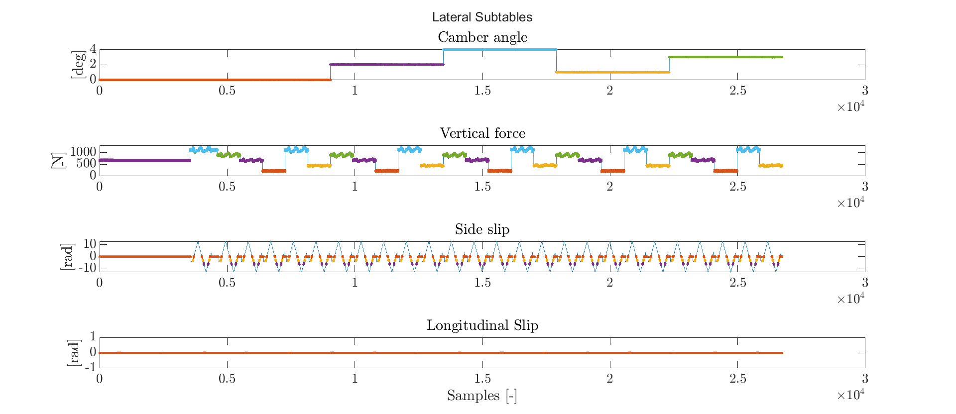
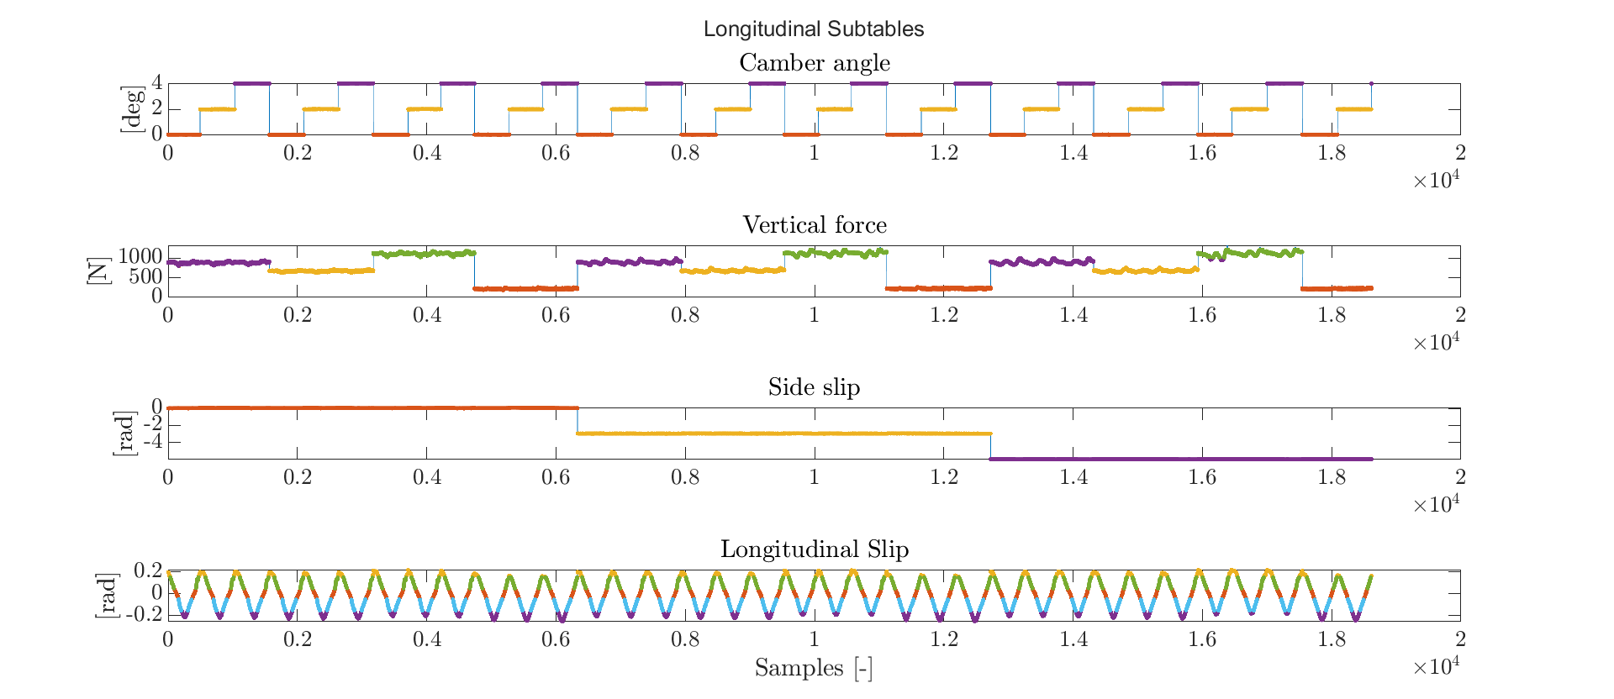
Tyre Fitting
The raw collected data of the tyres (Hoosier 6.8/18.0 – 10 LCO) of an F-SAE formula car have been fitted to extrapolate its semi-empirical Pacejka model coefficients.
The data were cut into a suitable window and divided into subtables to be intersected and further analysed.

Slide 3
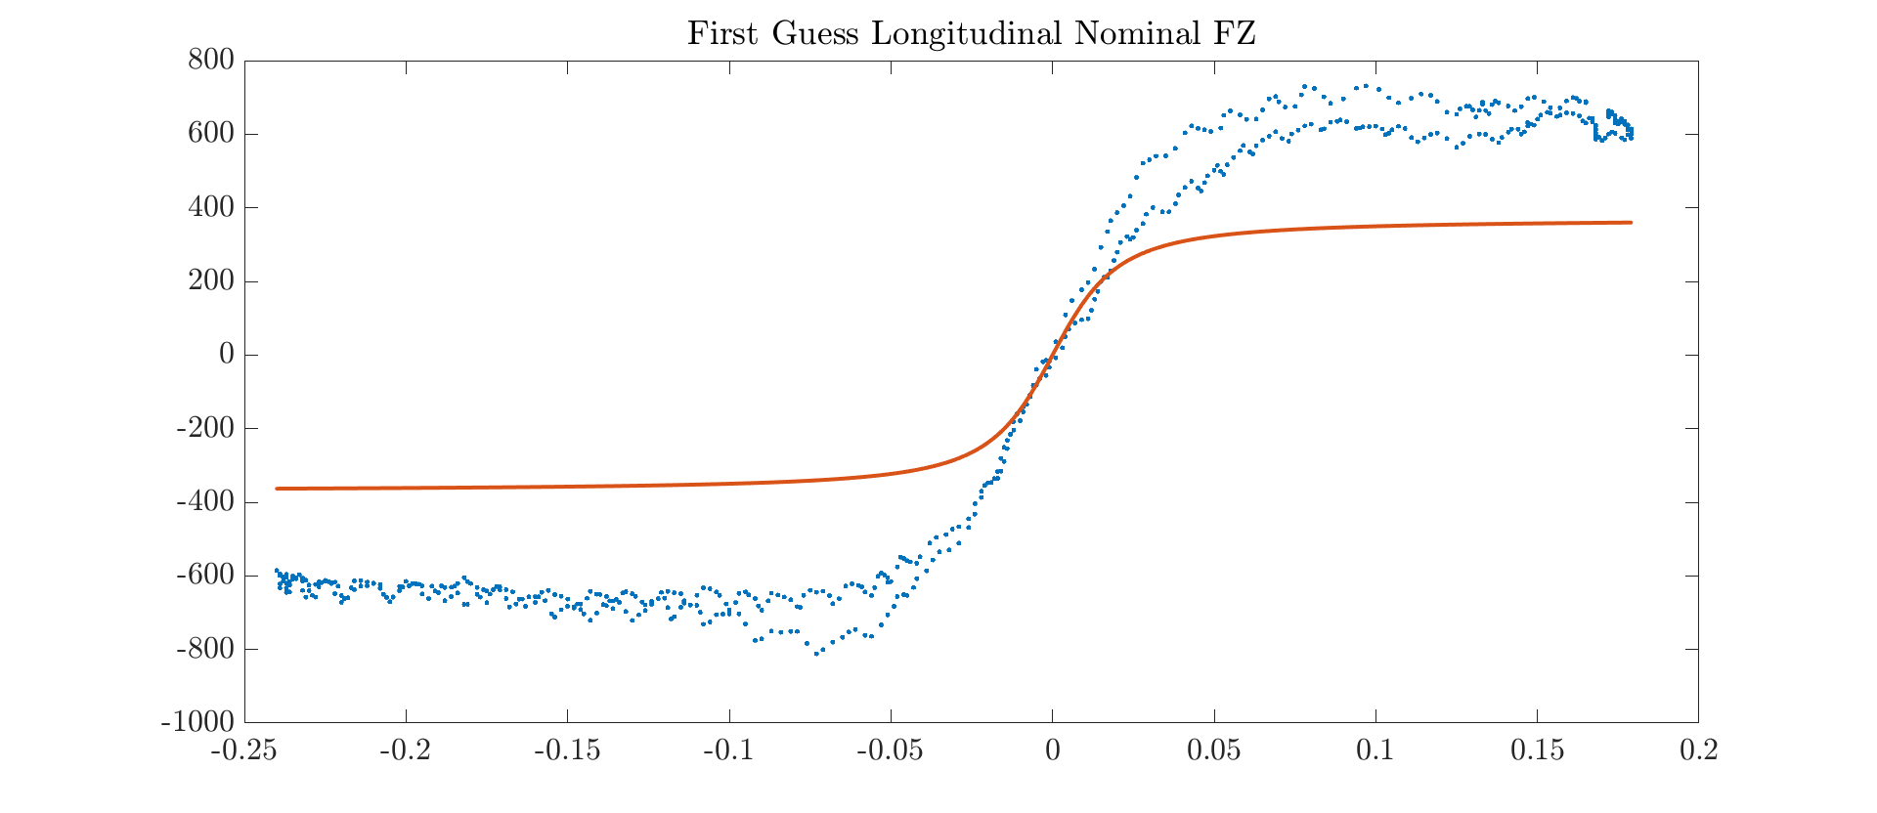
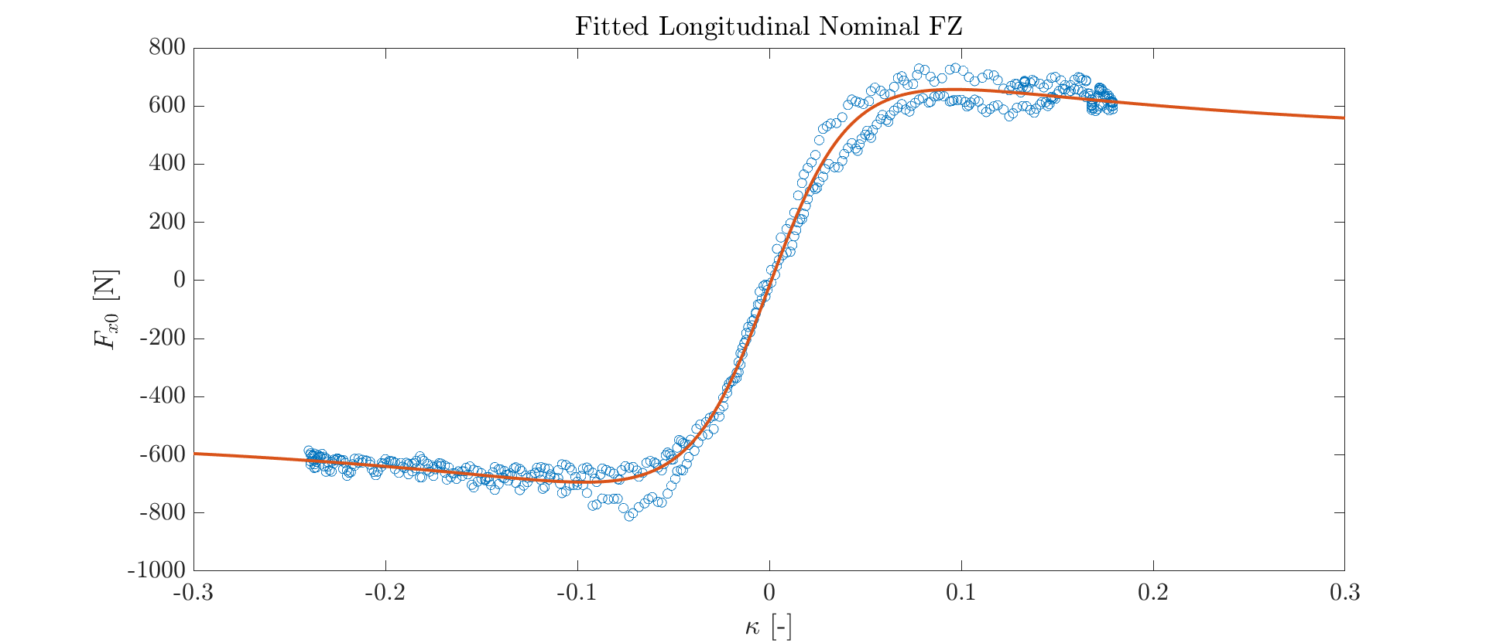

Longitudinal Forces
Nominal vertical force:
$$Fz = 220 [N]$$
First guess:
P0 = [1, 2, 1, 0, 0, 75, 0]
Boundaries:
Lb = [1, 0.1, 0, 0, -10, 0, 10]
Ub = [2, 4, 1, 1, 10, 100, 10]
Residuals:
$$R^{2}=0.995$$

Slide 4
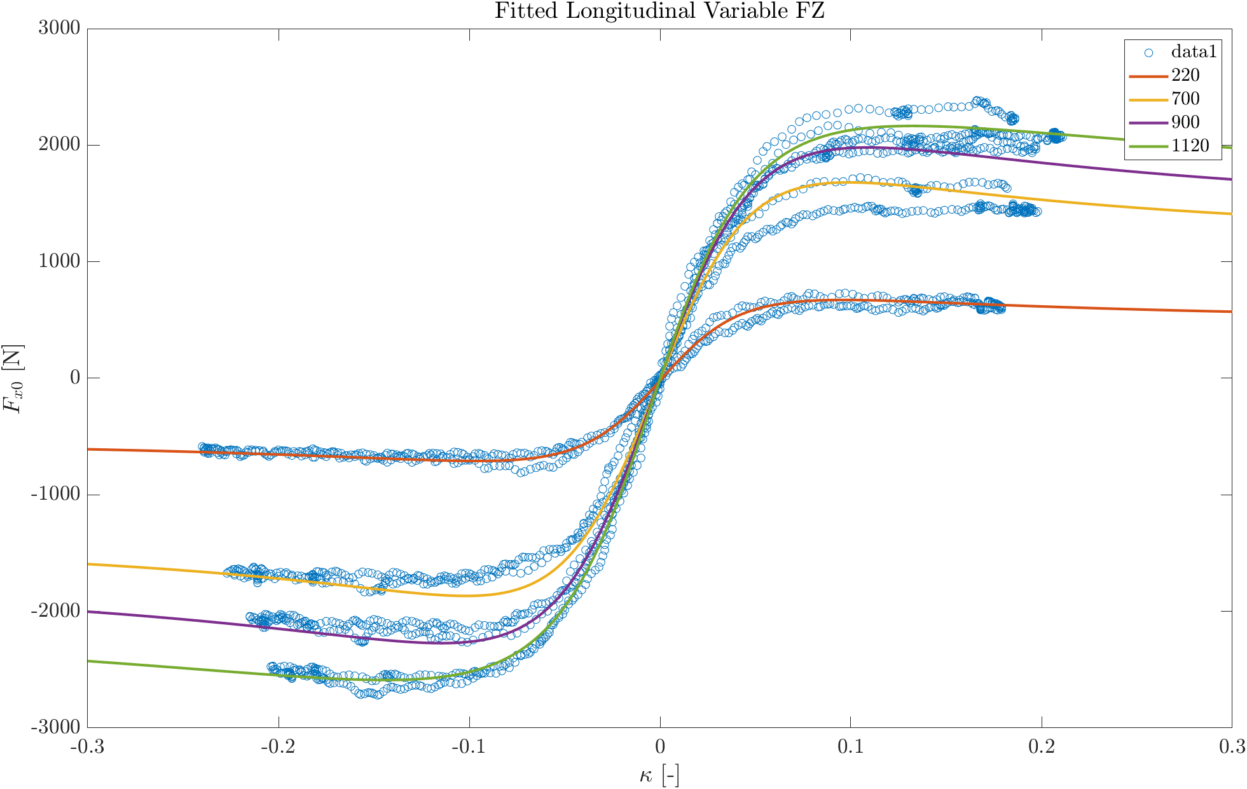
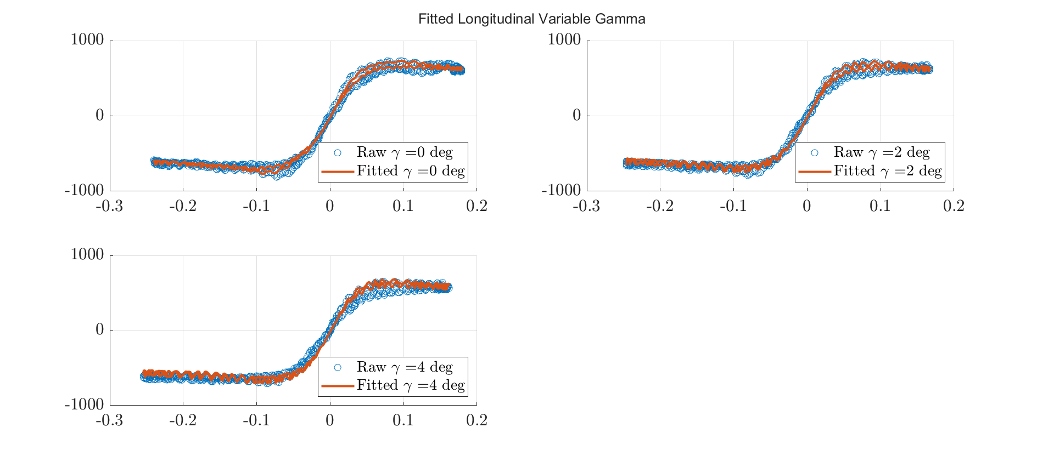

Longitudinal Forces
Variable nominal force and variable camber:
$$Fz = \left[220, 700, 900, 1120\right] [N]$$
$$γ=\left[0, 2, 4\right] [deg]$$
First guess:
${P0}_{Fz}$ = [-0.1, 0, 0, 0, 0, 0, 0]
${P0}_{γ}$ = [15]
Boundaries:
${Lb}_{Fz}$ = [-1, -1, -1, -1, -100, -10, -1]
${Ub}_{Fz}$ = [0, 1, 1, 1, 100, 10, 1]
${Lb}_{γ}$ = [10]
${Ub}_{γ}$ = [20]
Residuals:
$${R_{Fz}}^{2}=0.997$$
$${R_{γ}}^{2}=0.991$$

Slide 5
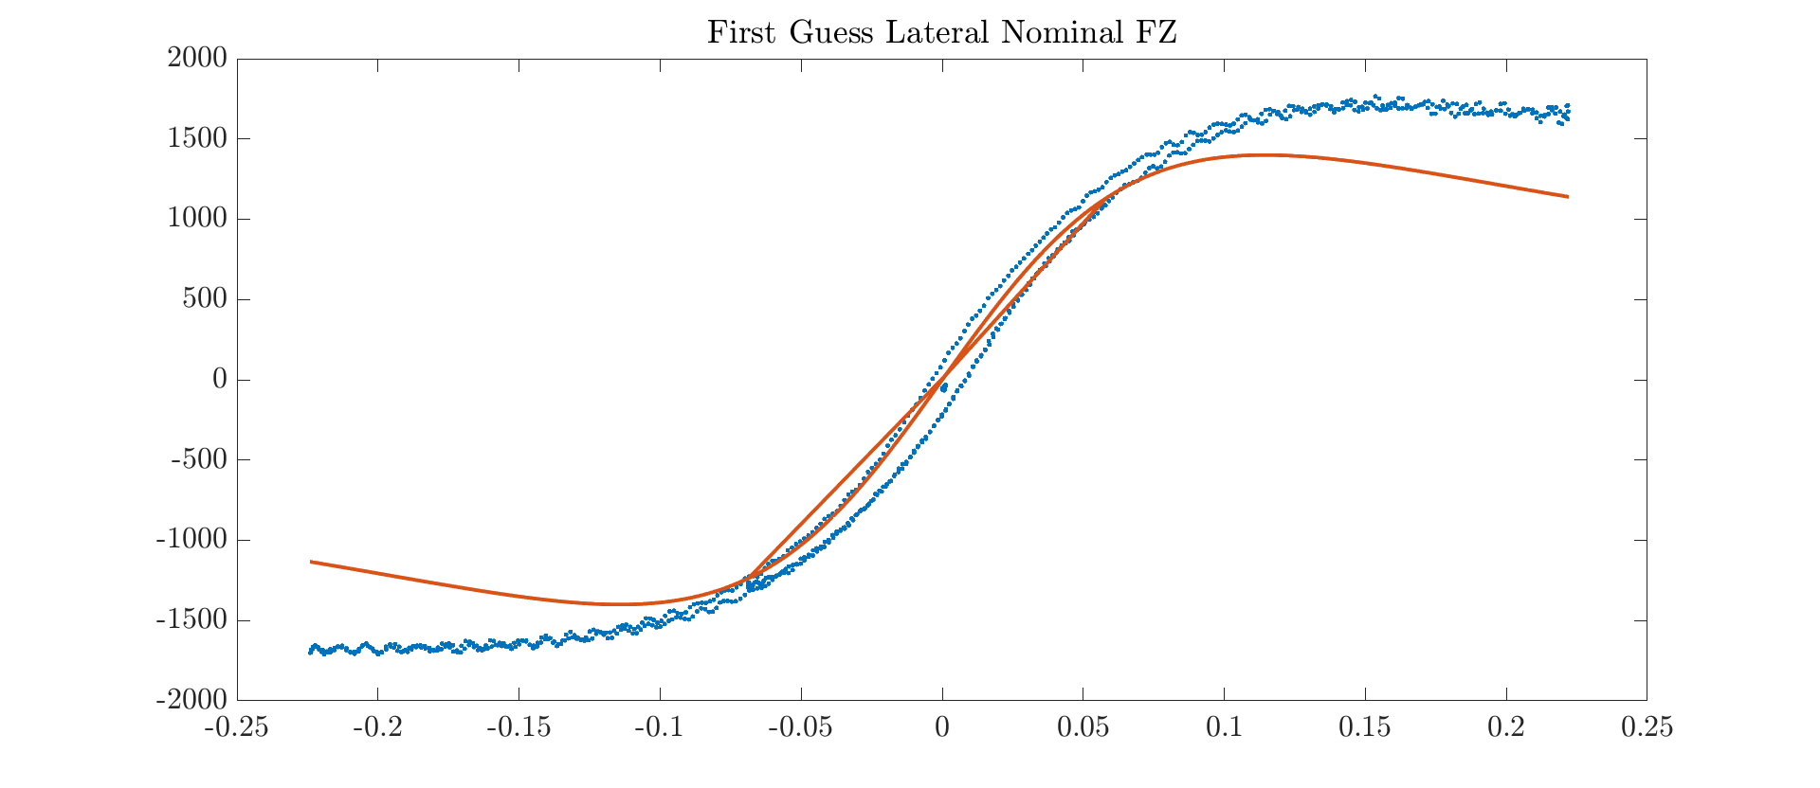
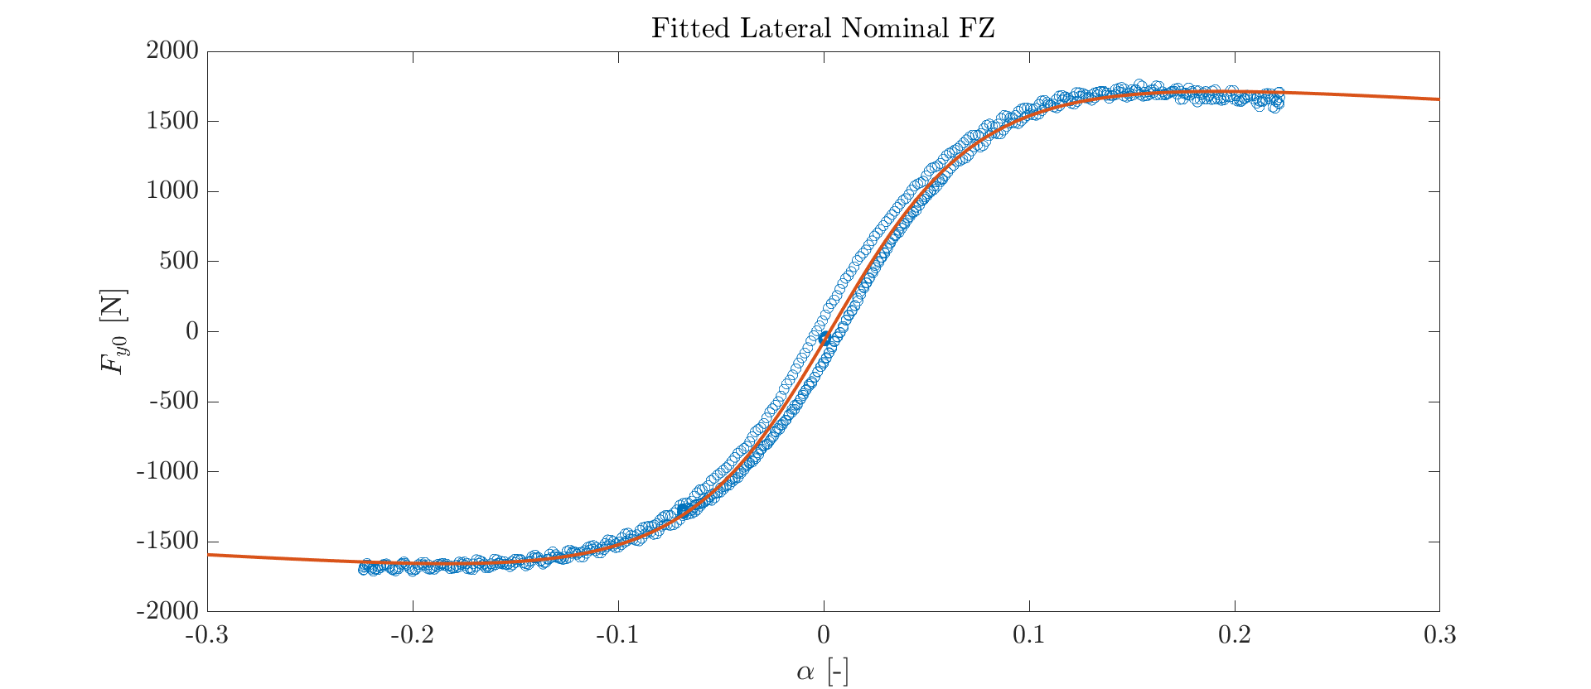

Lateral Forces
Nominal vertical force:
$$Fz = 700 [N]$$
First guess:
P0 = [-2, -2, 0, 0, 35, 1, 0]
Boundaries:
Lb = [-10, -7, -1, -1, 20, 0, -1]
Ub = [0, 0, 1, 1, 50, 2, 1]
Residuals:
$$R^{2}=0.998$$

Slide 6
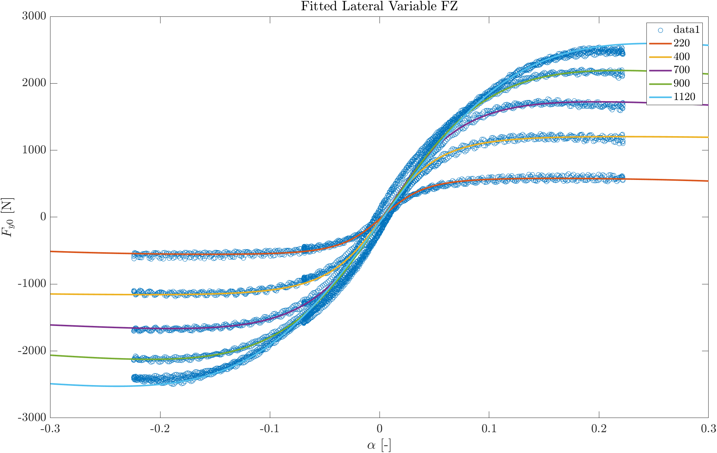
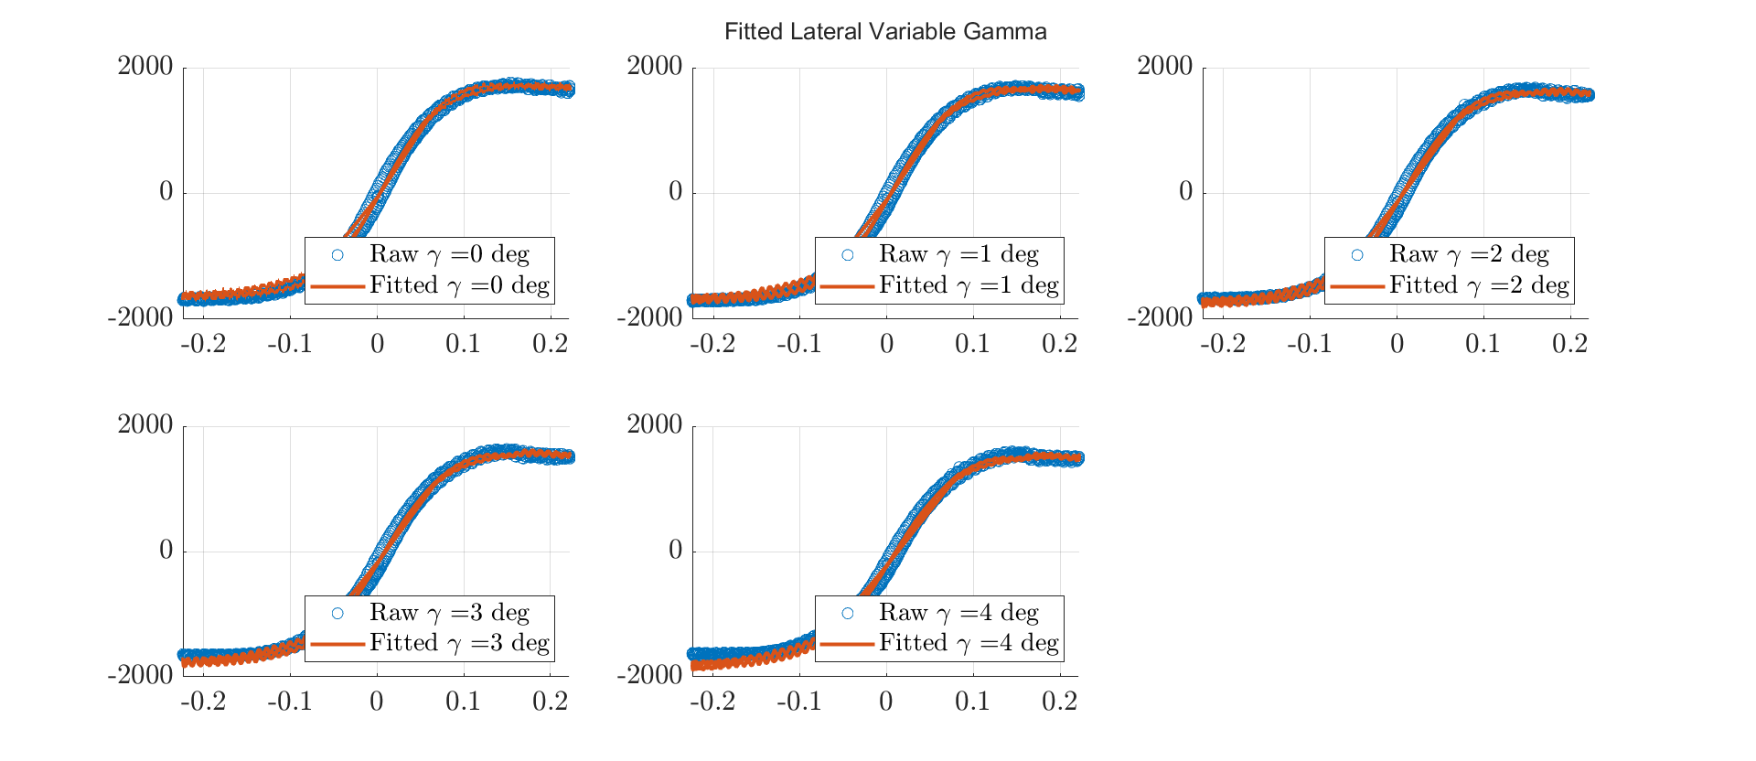

Lateral Forces
Variable nominal force and variable camber:
$$Fz = \left[220, 440, 700, 900, 1120\right] [N]$$
$$γ=\left[0, 1, 2, 3, 4\right] [deg]$$
First guess:
${P0}_{Fz}$ = [1, 0, 0, 1]
${P0}_{γ}$ = [1, 1, 1, 1, 0, 0, 0]
Boundaries:
${Lb}_{Fz}$ = [-10, -10, -10, -10]
${Ub}_{Fz}$ = [10, 10, 10, 10]
${Lb}_{γ}$ = [-3, 0, -2, 0, 0, -4, -1]
${Ub}_{γ}$ = [3, 2, 2, 2, 2, 1, 1]
Residuals:
$${R_{Fz}}^{2}=0.997$$
$${R_{γ}}^{2}=0.995$$

Slide 7
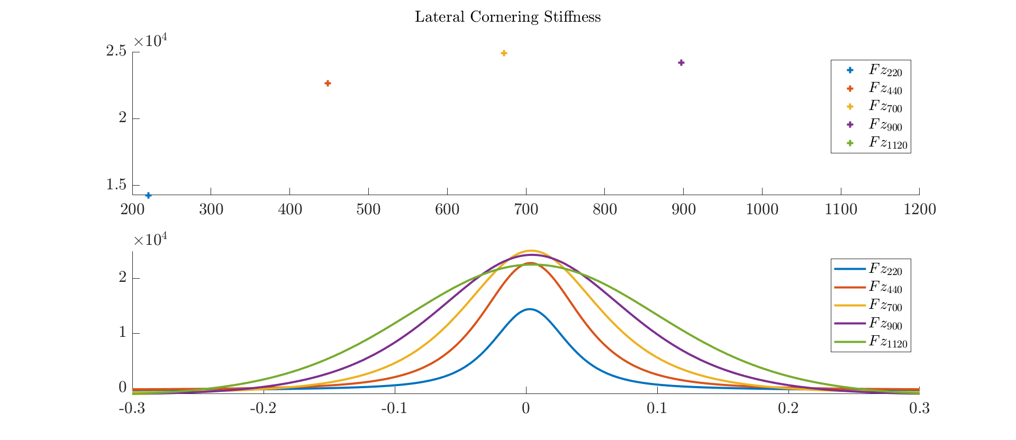
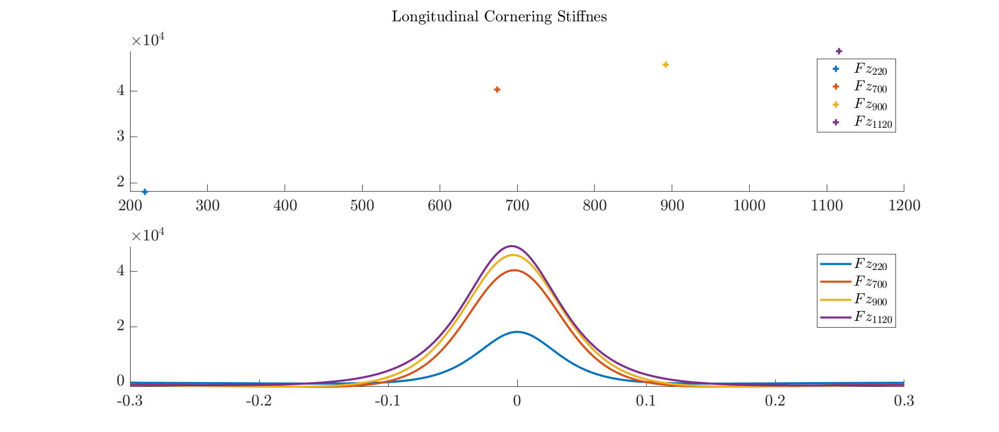
Cornering Stiffness
The cornering stiffness for both longitudinal and lateral forces has been plotted as function of κ and α respectively.

Slide 8
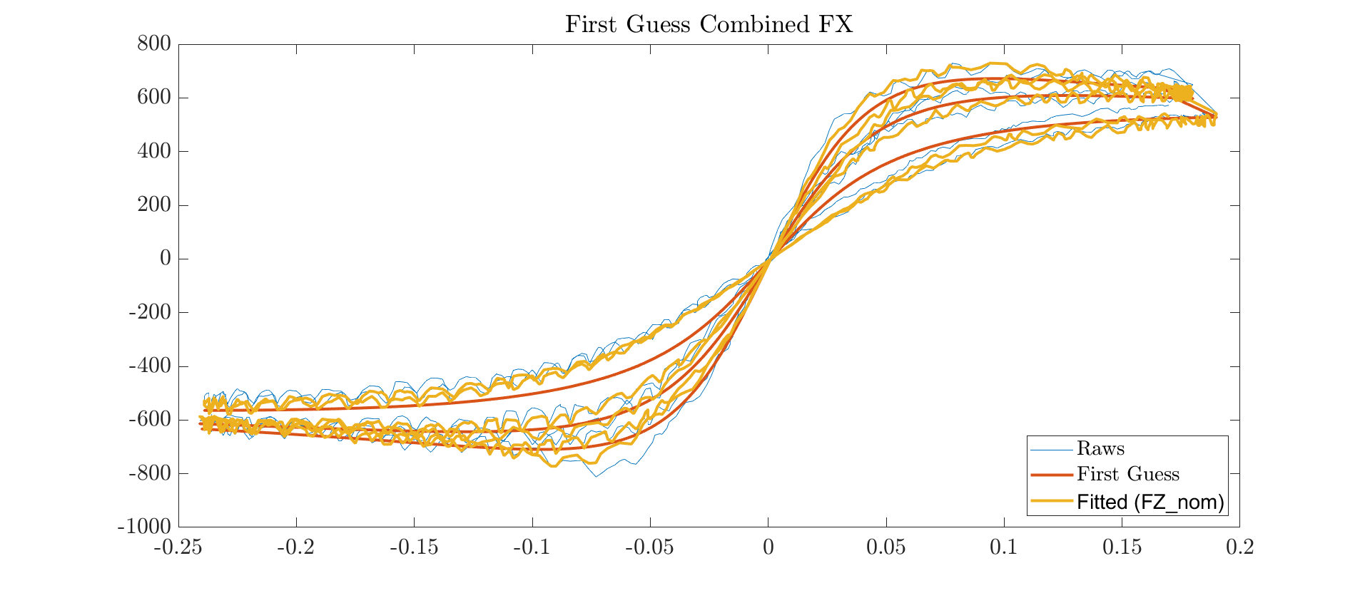
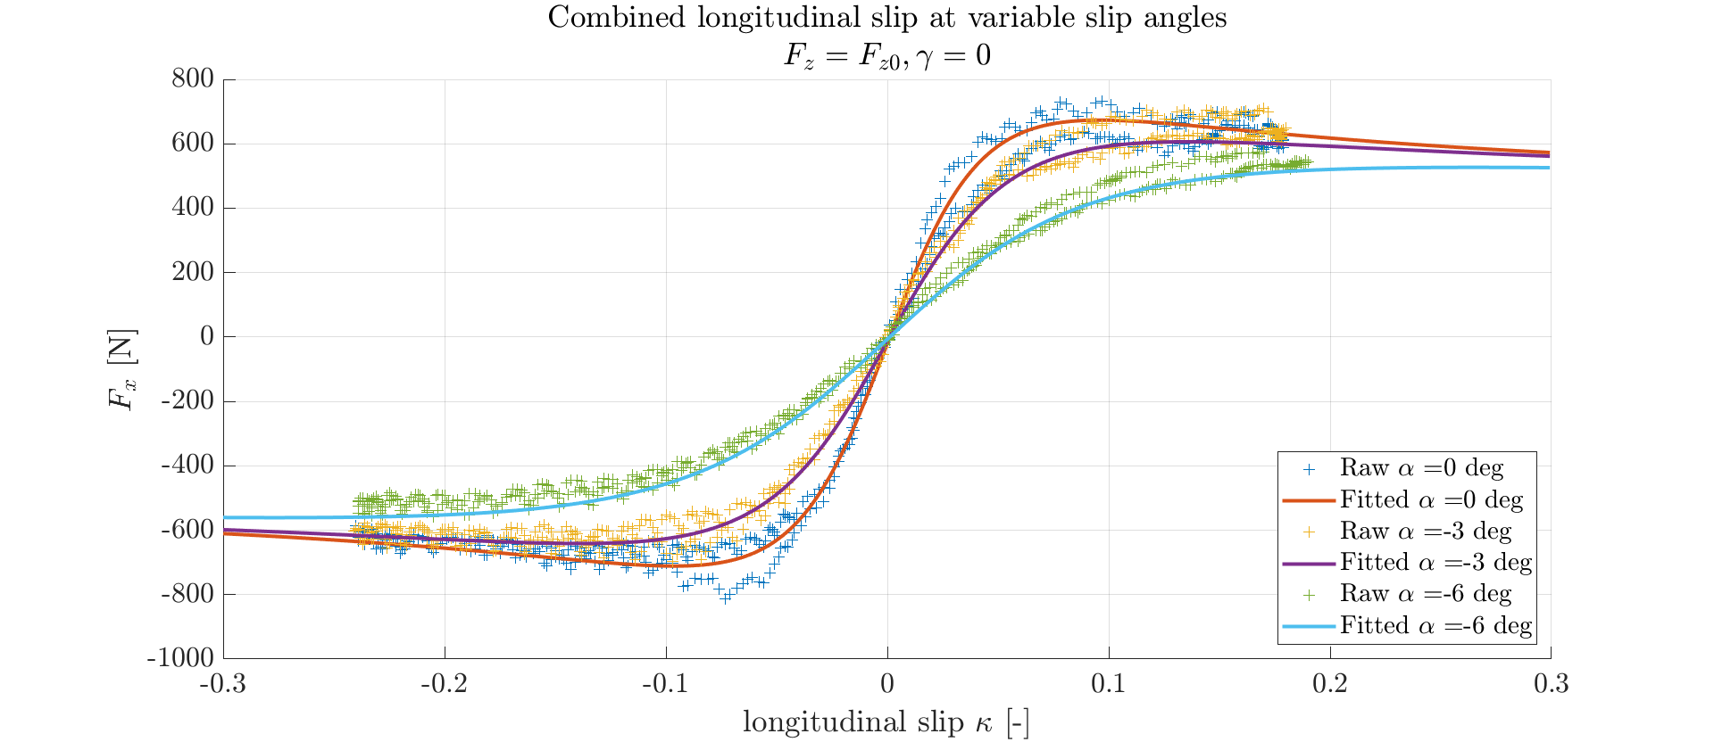

Combined Longitudinal
Nominal vertical force, null camber, variable slip:
$$Fz=220 [N]$$
$$γ=0 \left[deg\right]$$
$$α=\left[0, −3, −6\right][deg]$$
First guess:
P0 = [15, 12, 1, 0]
Boundaries:
Lb = [-20, -20, -20, -20]
Ub = [20, 20, 20, 20]
Residuals:
$$R^{2}=0.997$$

Slide 9
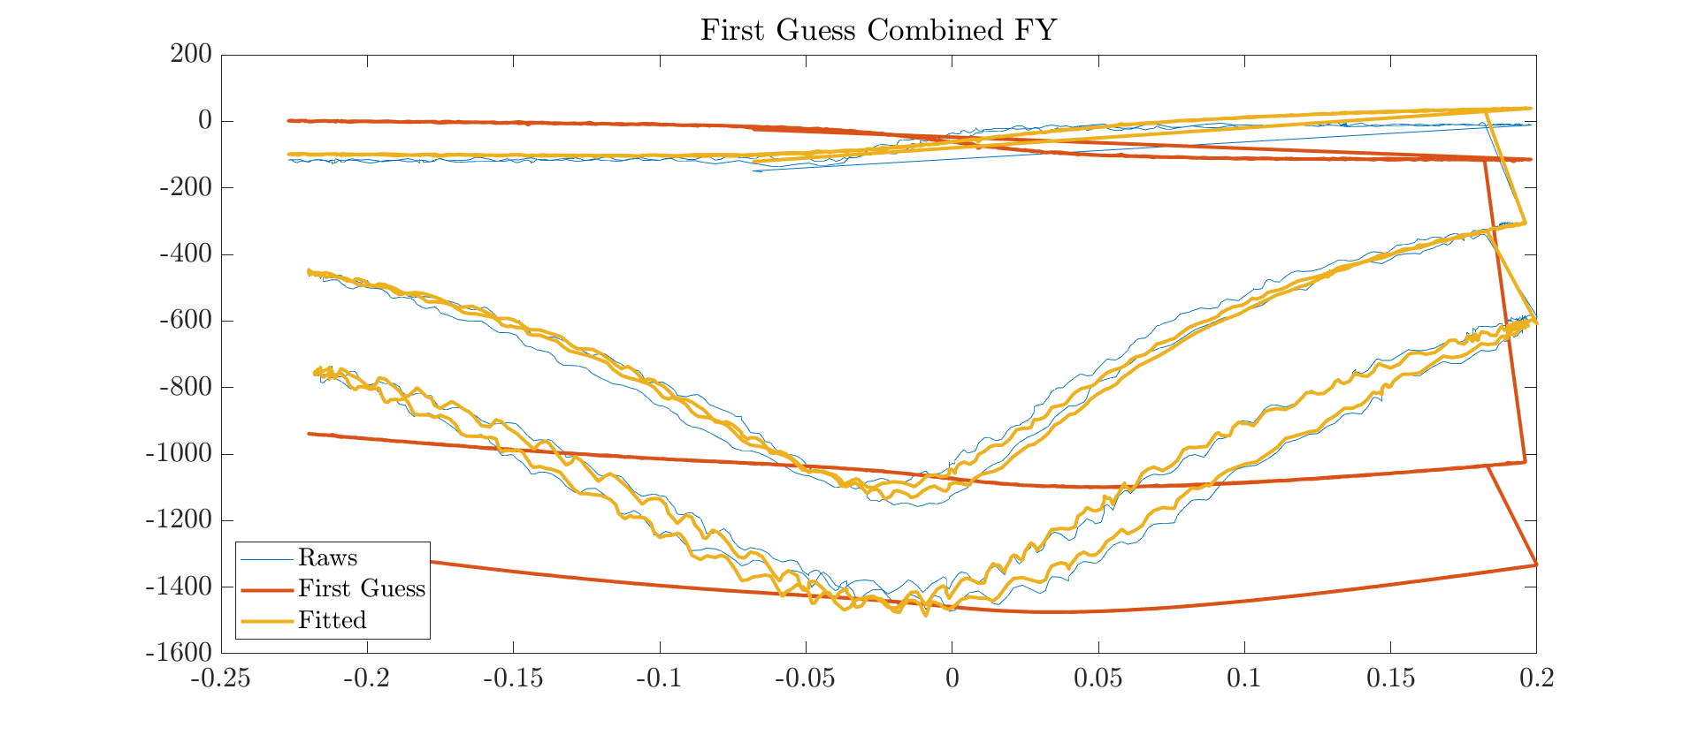
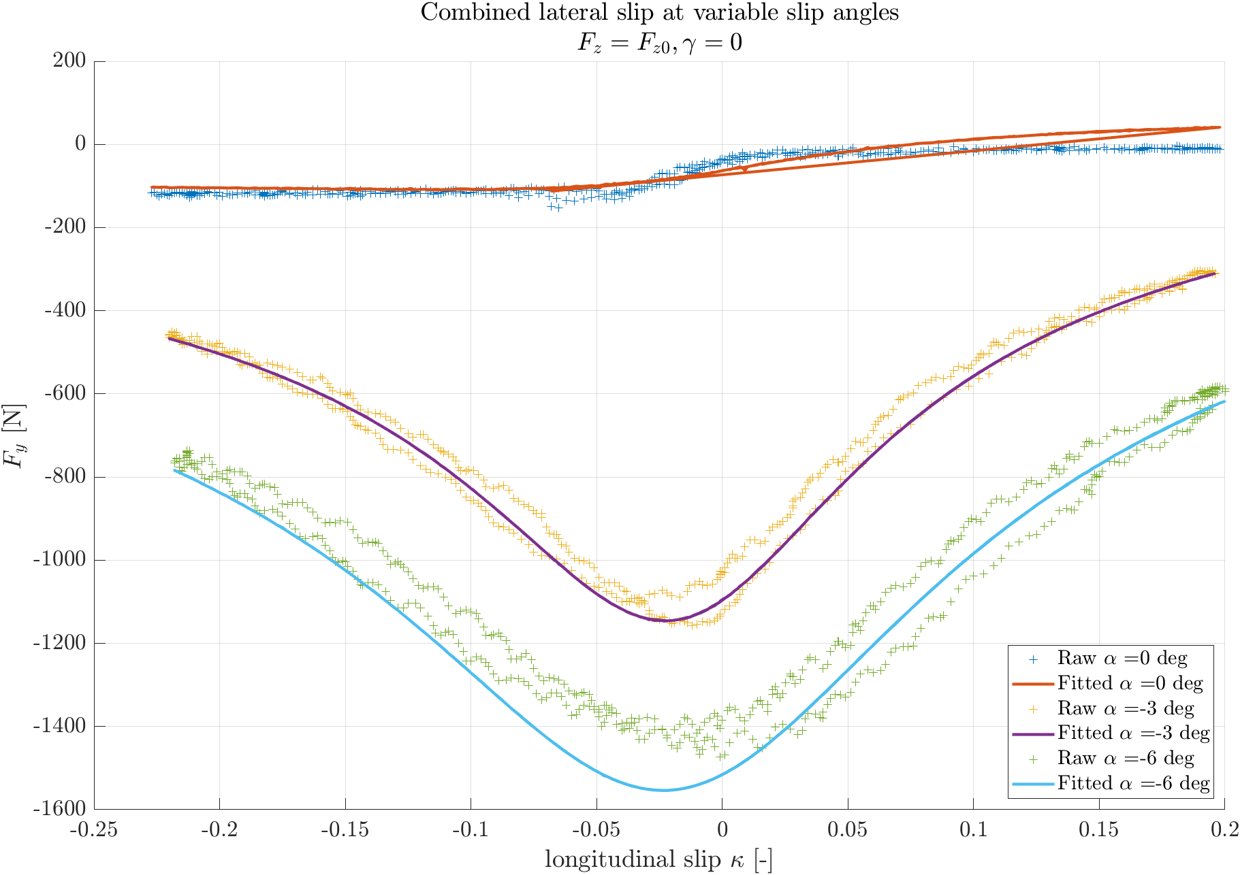

Combined Lateral
Nominal vertical force, null camber, variable slip:
$$Fz=700 [N]$$
$$γ=0 \left[deg\right]$$
$$α=\left[0, −3, −6\right][deg]$$
First guess:
P0 = [14, 13, -0.49, 0.9, 0.03, -0.27, 3.76, -0.09, 28.38]
Boundaries:
Lb = [-5, -5, -5, -5, -5, -5, -5, -5, -5]
Ub = [20, 20, 20, 20 , 20, 20, 20, 20, 20]
Residuals:
$$R^{2}=1.000$$

Slide 10
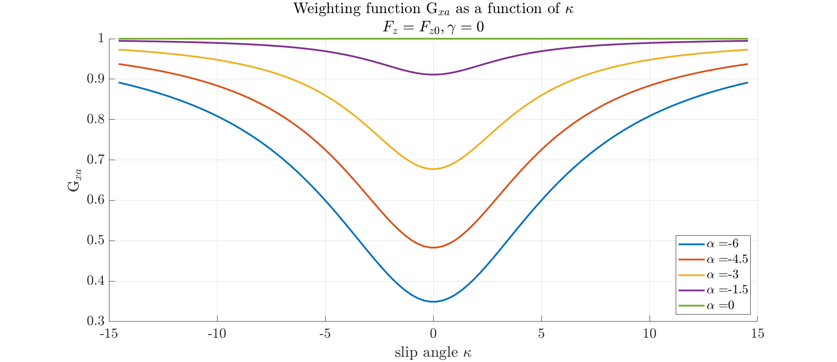
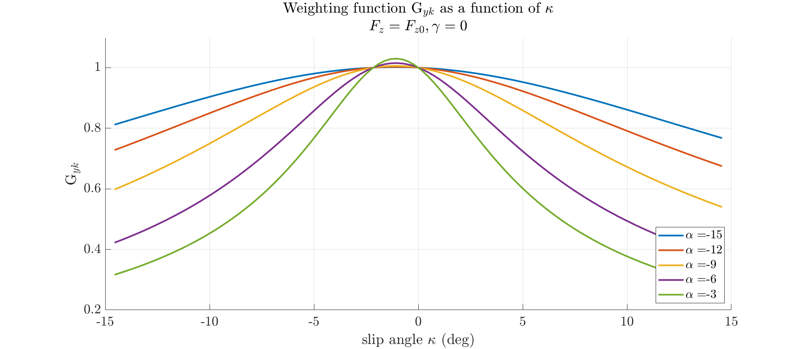
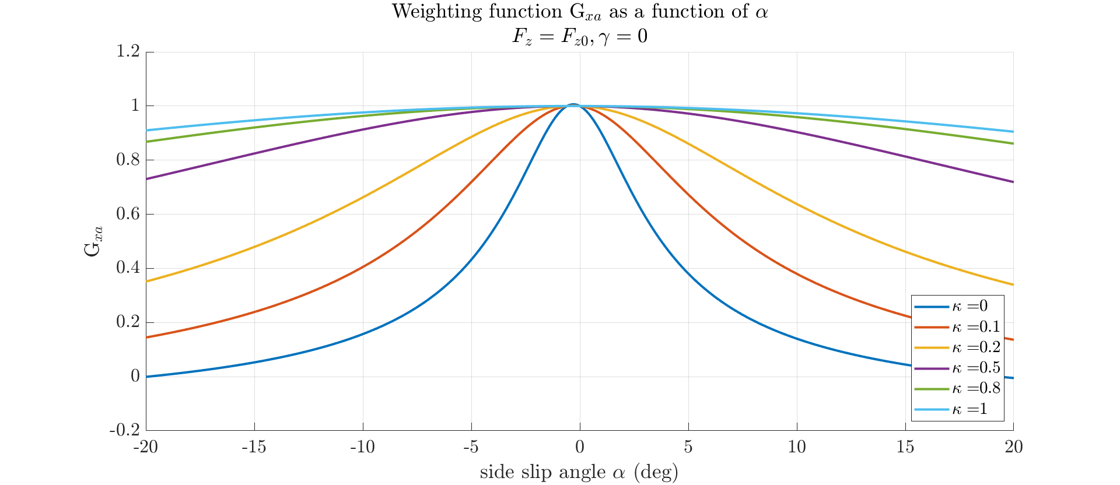
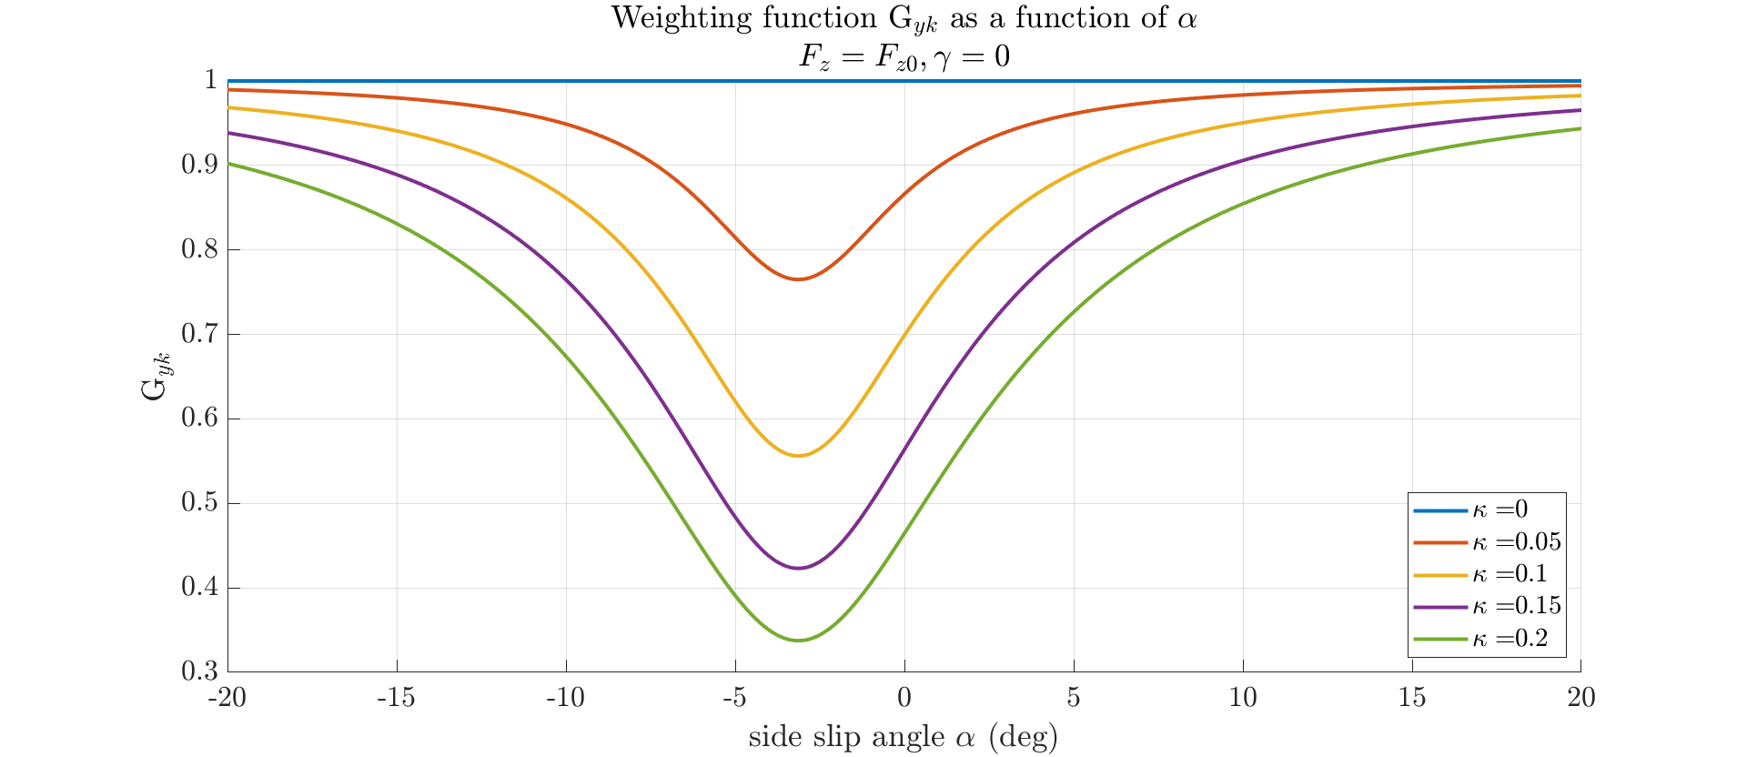
Weighting Functions

Slide 11
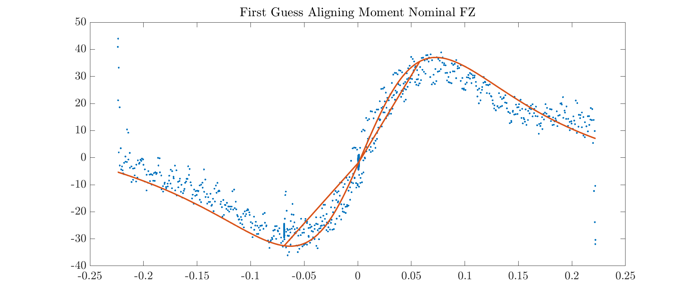
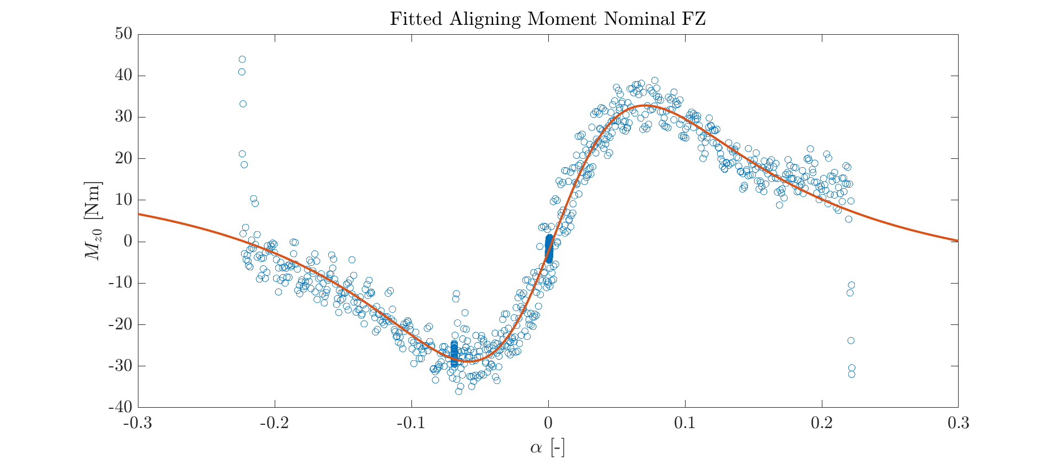

Self-Aligning Moment
Nominal vertical force:
$$Fz = 700 [N]$$
First guess:
P0 = [10, 13, 1.28, 1.28, -0.16, -0.2, -0.032, 0, 0, 0, 0.28, -0.005]
Boundaries:
Lb = [7, 10, 0.5, 0.5, -1, -1, -1, -1, -1, -2, -10, -1]
Ub = [15, 16, 2, 2, 0, 1, 1, 1, 1, 0, 3, 0]
Residuals:
$$R^{2}=0.931$$

Slide 12
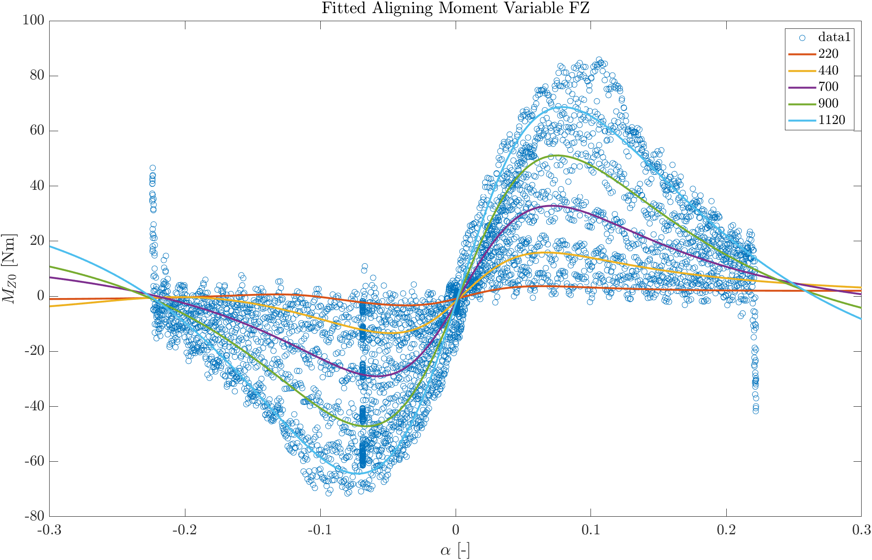


Self-Aligning Moment
Variable nominal force and variable camber:
$$Fz = \left[220, 440, 700, 900, 1120\right] [N]$$
$$γ=\left[0, 1, 2, 3, 4\right] [deg]$$
First guess:
${P0}_{Fz}$ = [1.9, 0.2, 0, 0, -0.01]
${P0}_{γ}$ = [-1.4, 0.9, -2, -1.8, 1.5, -1, 1, 0.65, 0.07]
Boundaries:
${Lb}_{Fz}$ = [-5, -5, -1, -1, -1]
${Ub}_{Fz}$ = [5, 5, 1, 1, 1]
${Lb}_{γ}$ = [-3, 0, -2.5, -2.5, 0, -5, -1, -1, -1]
${Ub}_{γ}$ = [3, 2, 2, 2, 2, 5, 2, 1, 1]
Residuals:
$${R_{Fz}}^{2}=0.957$$
$${R_{γ}}^{2}=0.800$$

Slide 13
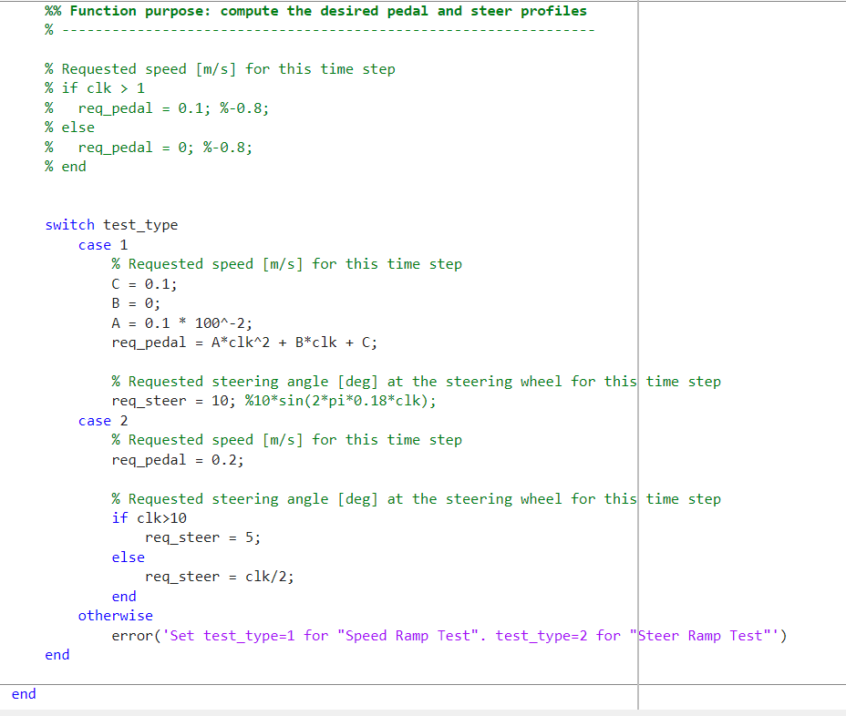
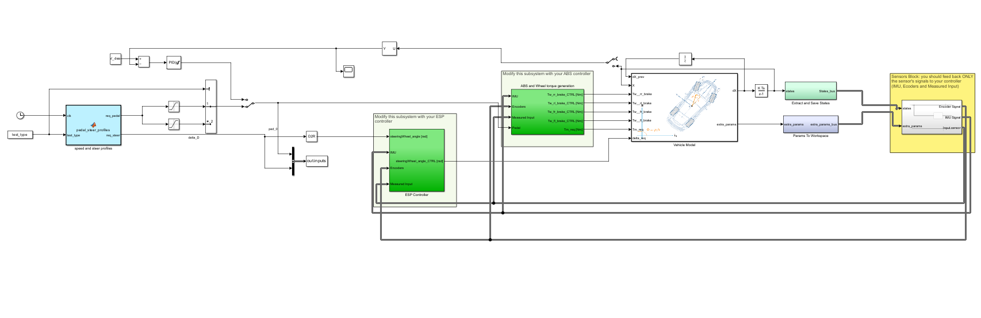
Simulink model
The Vehicle model has been used to simulate the dynamical behaviour of a Formula Car in two Steady State tests:
Constant steering angle varying the pedal in input
Constant pedal varying the steering angle in input

Slide 14
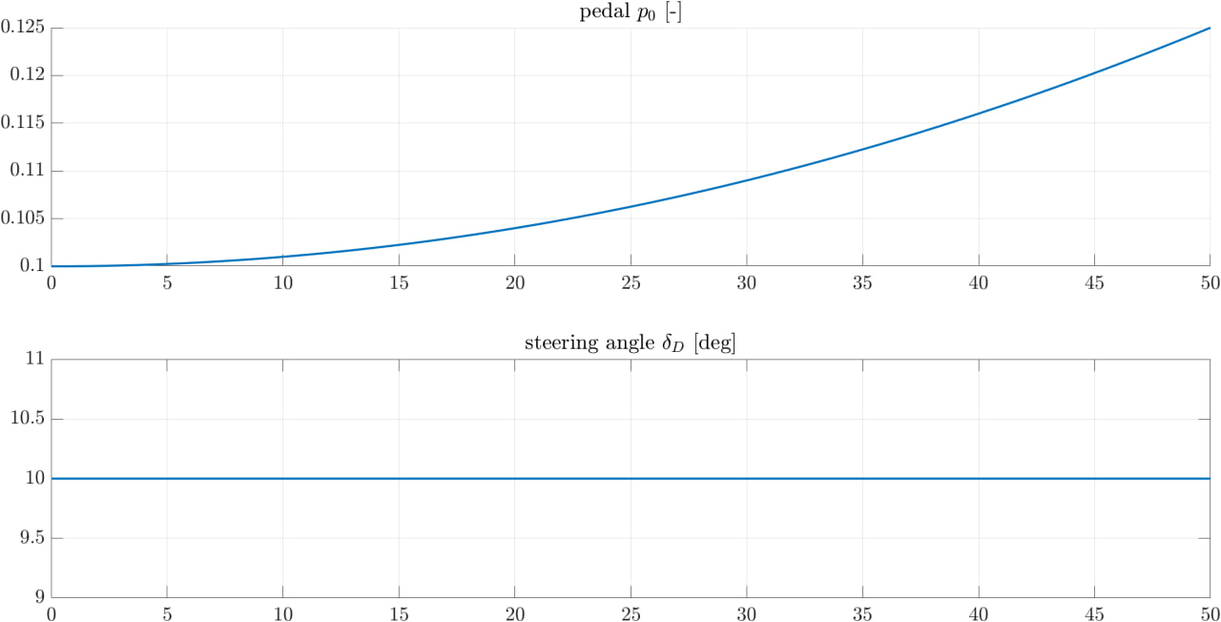
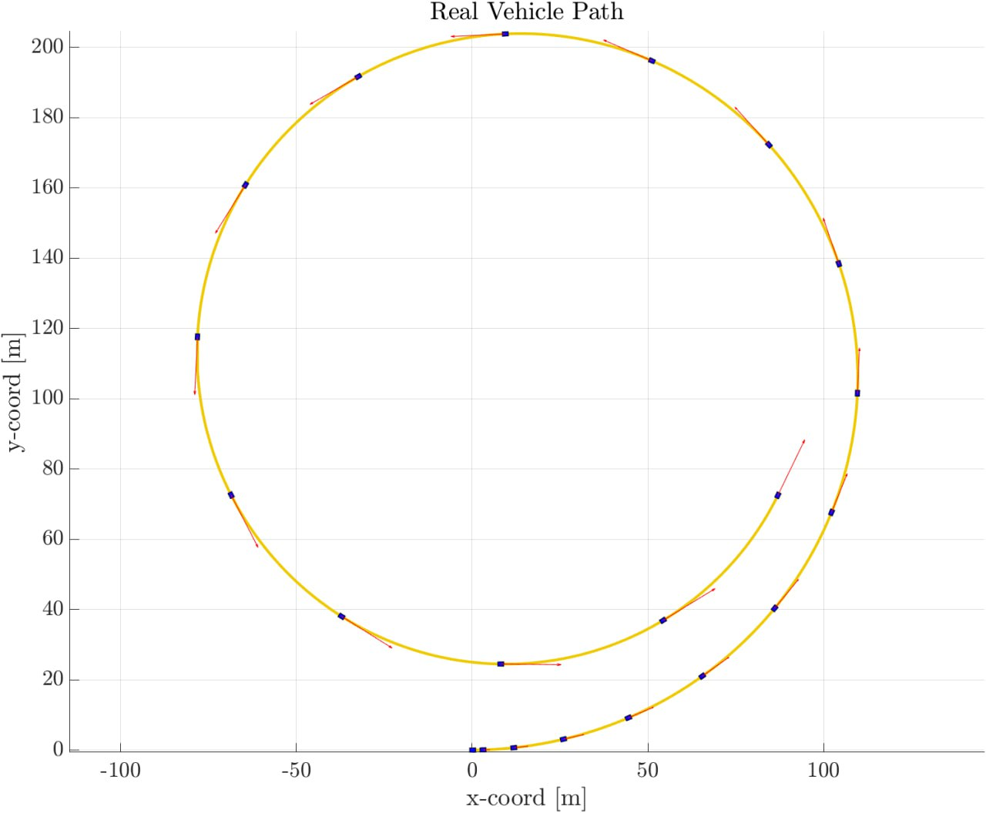
Speed test
The system has been studied considering a lateral/turning steady state problem:
0 [km/h] initial velocity
50 seconds simulation
Parabolic arm speed ramp
Constant 10 [deg] steering angle
The vehicle Path shows clearly the Oversteering tendency of the vehicle.

Slide 15
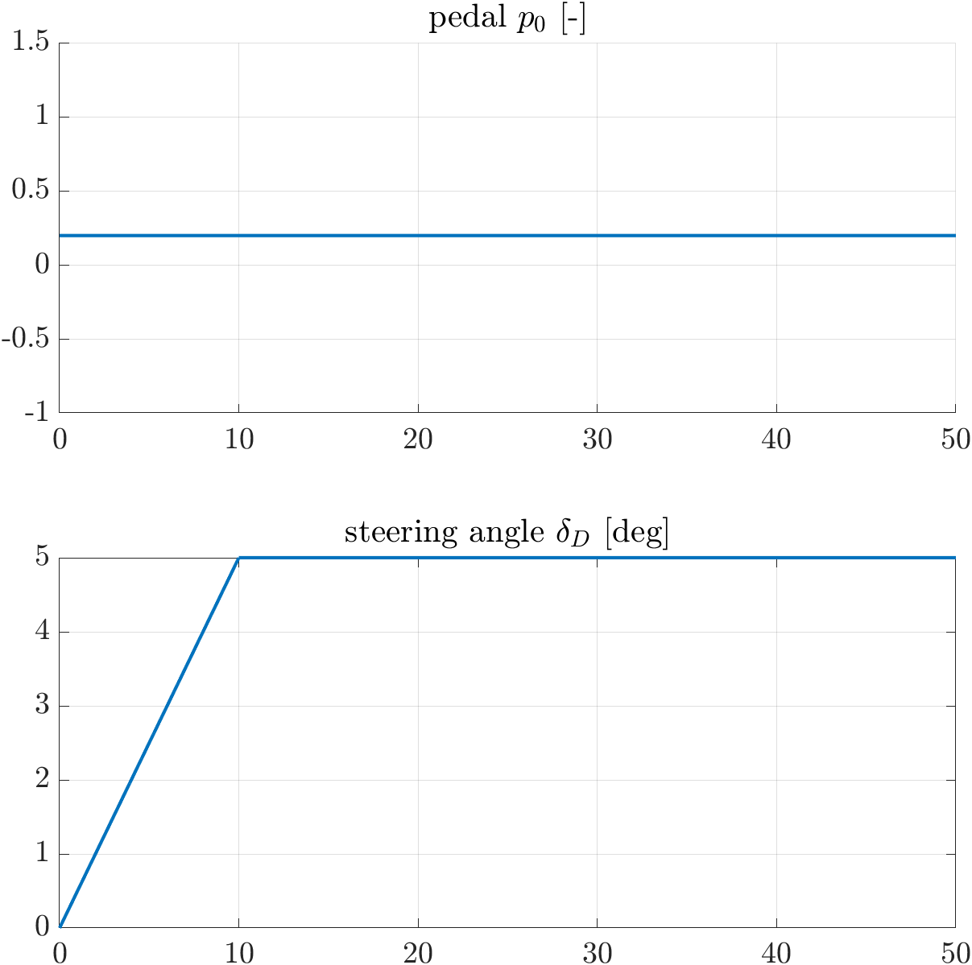
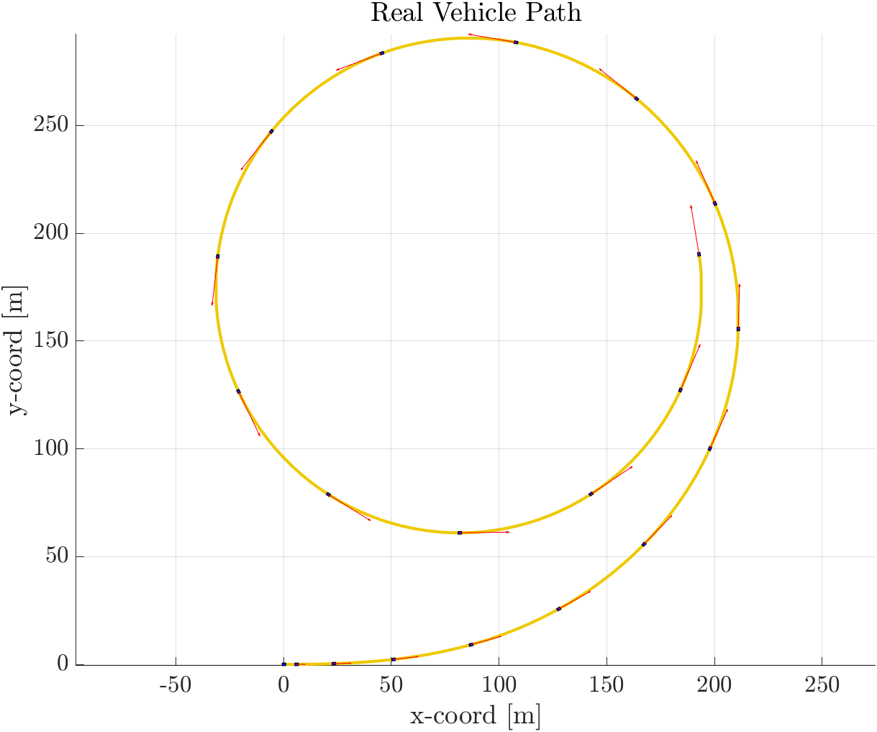
Steer test
The system has been studied considering a lateral/turning steady state problem:
50 seconds simulation
0 [km/h] initial velocity
Linear and saturated steer ramp
Constant 0.2 pedal input
The vehicle Path has the typical snail shape.

Slide 16
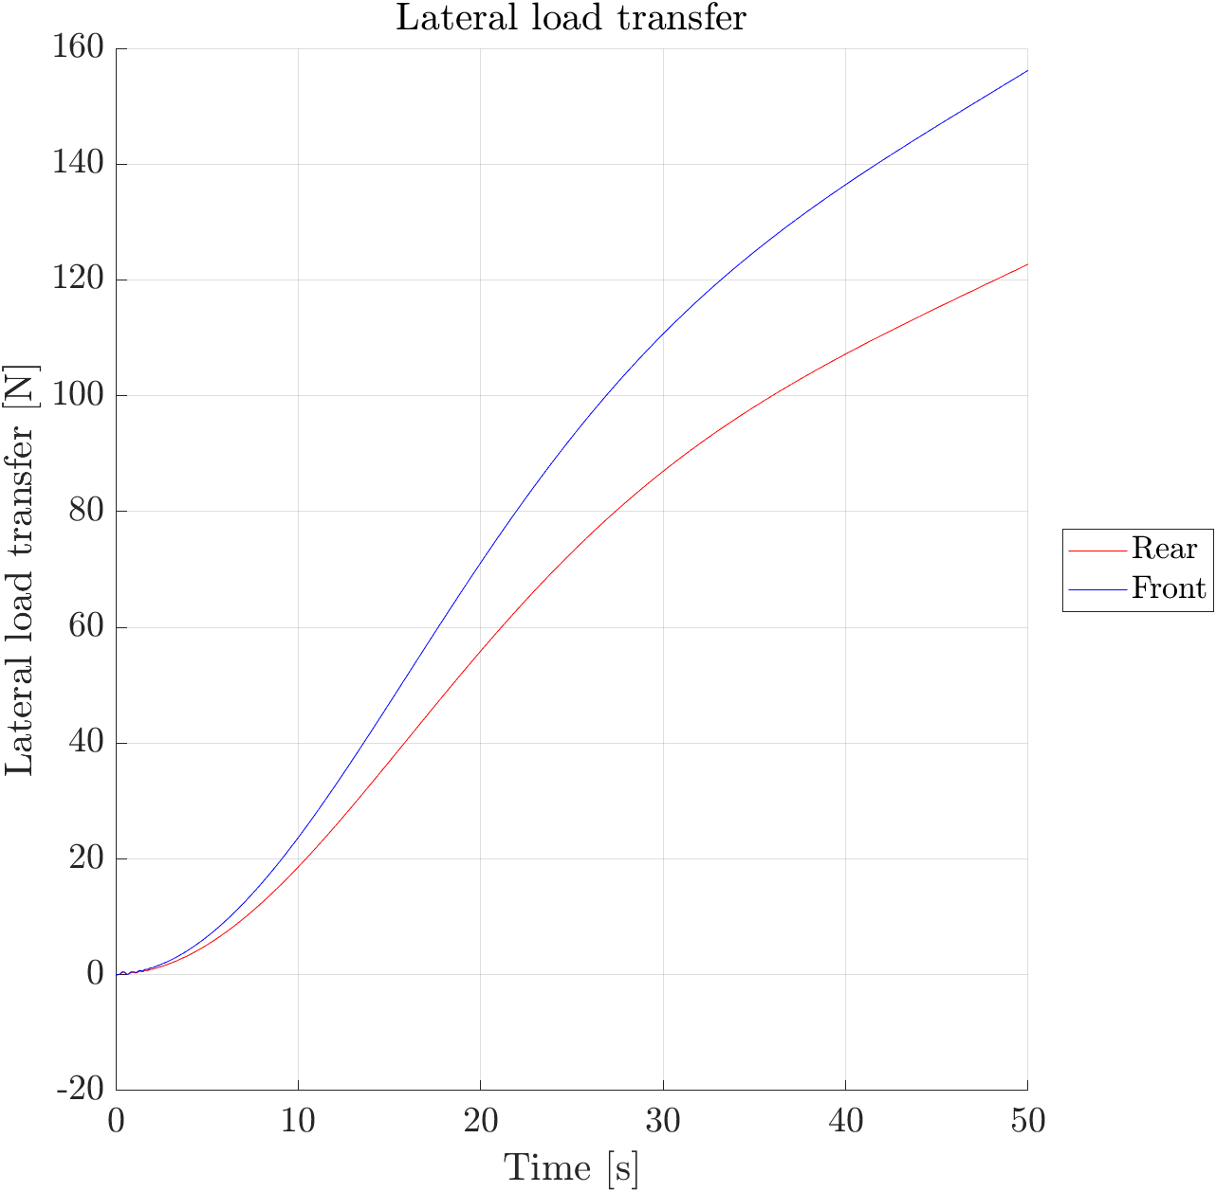

Lateral Load Transfer
Lateral load transfer has been calculated taking into account the instantaneaous term and the transient/elastic term.
${∆F}_{xf}=ma_{y}(\frac{Lr h_{rf}}{LW_{f}}+ \frac{h_{s}}{w_{f}}\frac{K_{φf}^{s}}{K_{φf}^{s}+K_{φr}^{s}})$
${∆F}_{xr}=ma_{y}(\frac{Lf h_{rr}}{LW_{r}}+ \frac{h_{s}}{w_{r}}\frac{K_{φr}^{s}}{K_{φf}^{s}+K_{φr}^{s}})$
There is a linear part between 10 and 30 seconds.
Saturation is never reached.

Slide 17
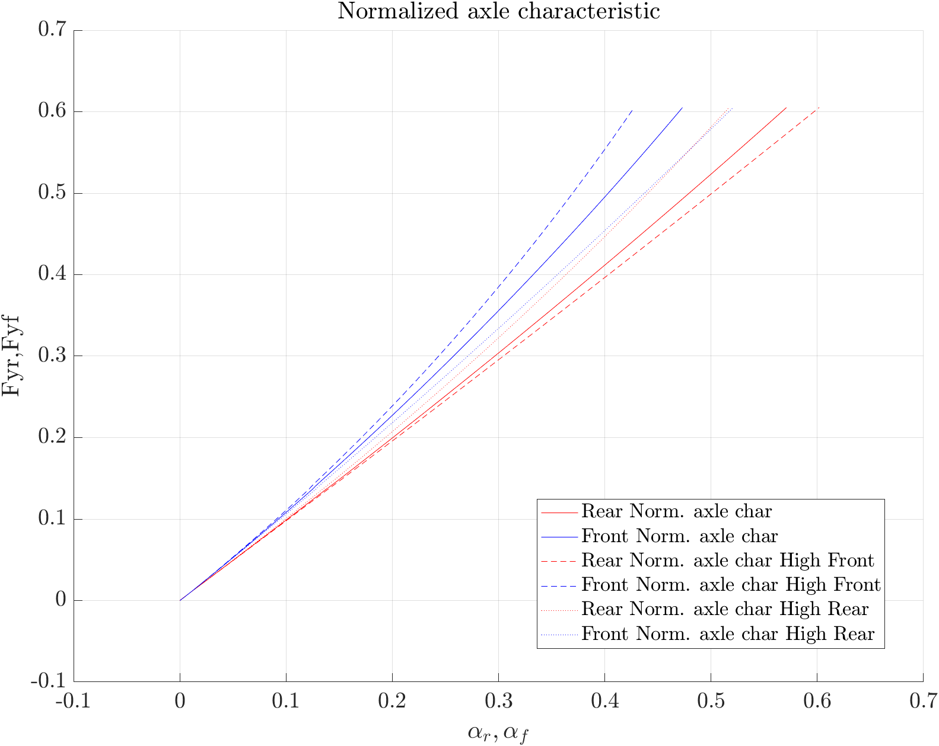

Normalized axle characteristics
Computed through $μ=\frac{Y}{F_{z0}}$
Computed introducing a 67% increase on the front stiffness through an anti-roll bar (Dashed line)
Computed introducing a 67% increase on the rear stiffness through an anti-roll bar (Spotted line)

Slide 18
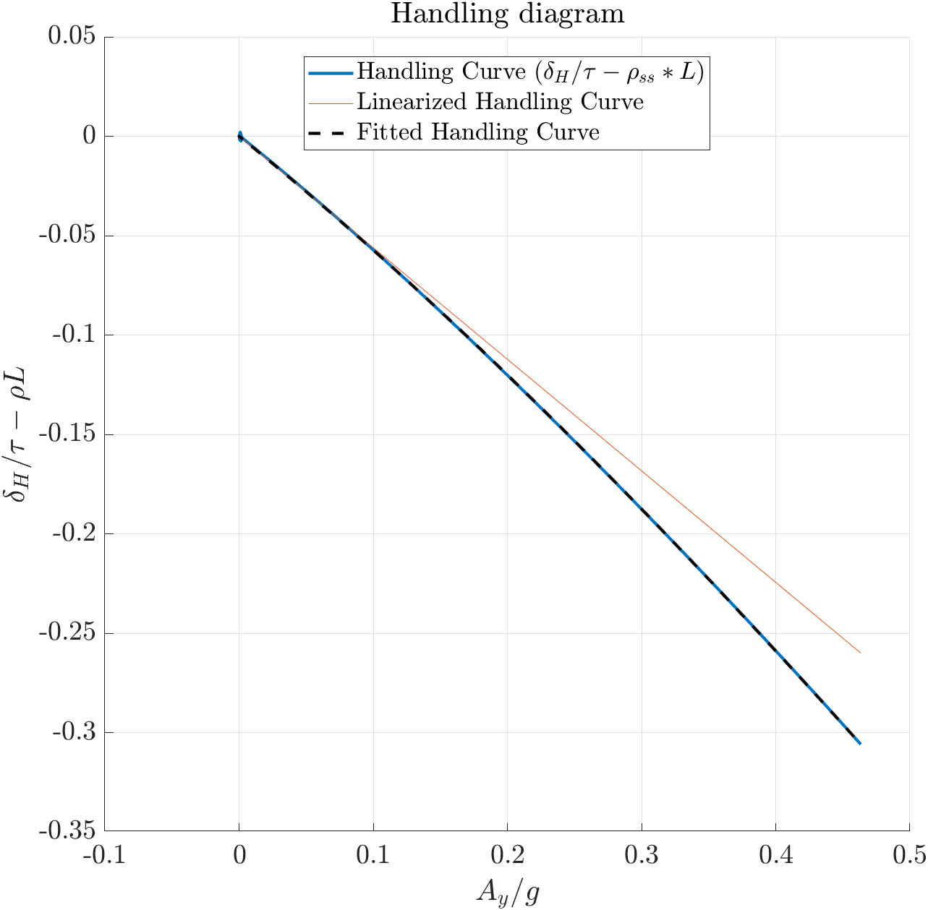

Handling diagram
Handling Curve:
$${\frac{δ_{D}}{τ_{D}}−ρ}_{ss}∗L=α_{f}{− α}_{r}$$
The Handling curve can be fitted defining a polynomial whit the linear coefficient $K_{us}$ and higher order coefficients $K_{{us}_{i}}$ (for the non-linear part):
${\frac{δ_{D}}{τ_{D}}−ρ}_{ss}∗L= K_{us}$ $a_{y}+$ $K_{{us}_{1}}{a^{y}}^{2}$ $+$ $K_{{us}_{2}}{a^{y}}^{3}…$
$K_{{us}_{theor}}$= 5.76 x ${10}^{−4}$
$K_{{us}_{fit}}$ = 9,4 x ${10}^{−3}$

Slide 19
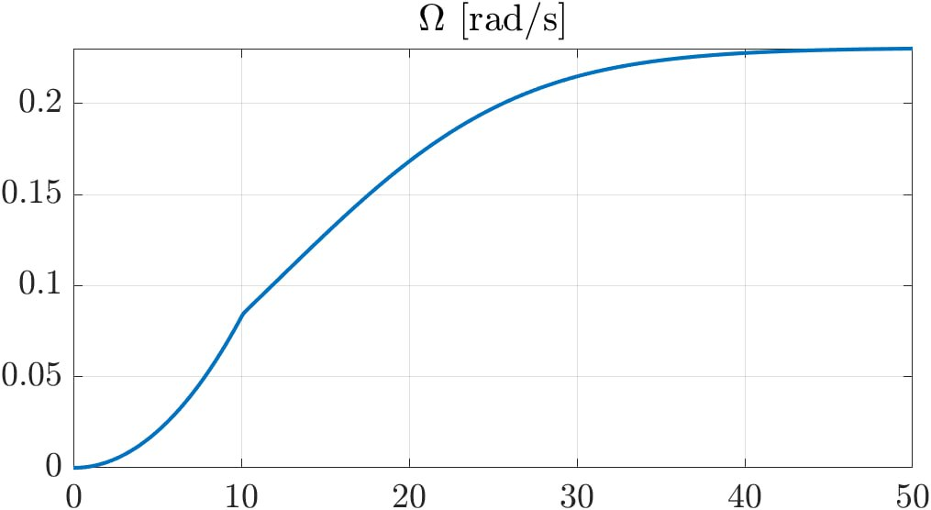
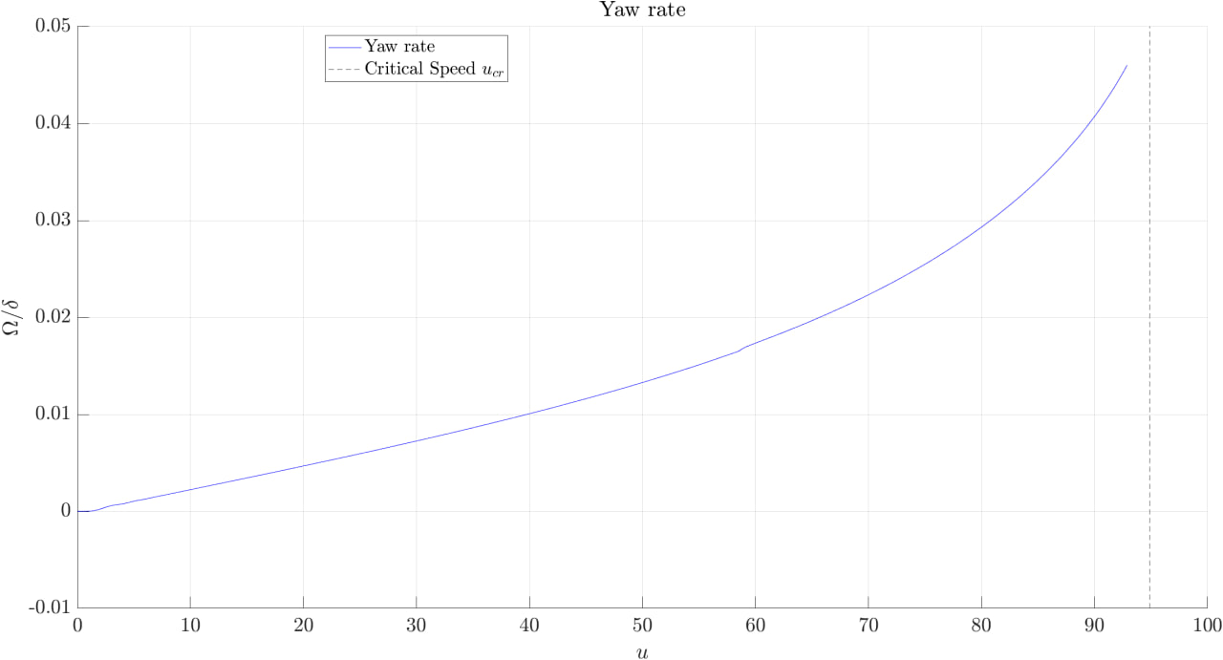

Yaw rate
Given the vehicle’s oversteering behavior it is possible to visualize the critical velocity:
$u_{cr}= \sqrt{\frac{1}{K_{us}}}≅95 [km/h]$
After reaching the critical velocity it is necessary to decrease the steering angle.

Slide 20
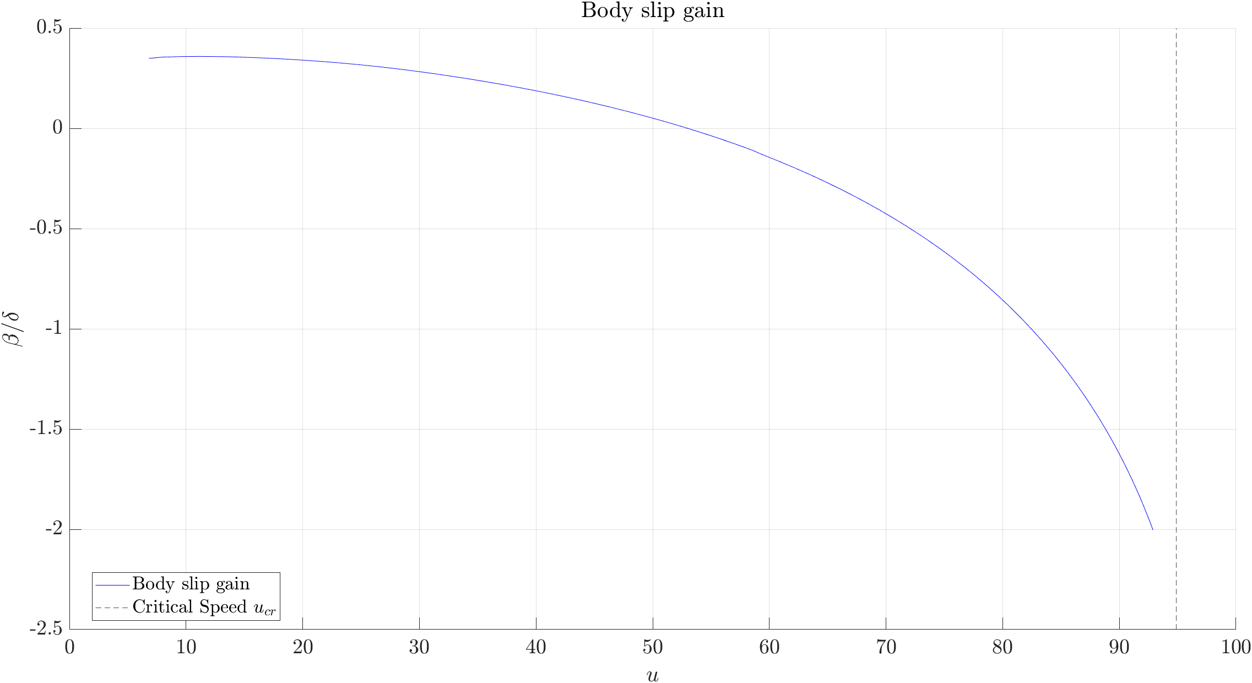
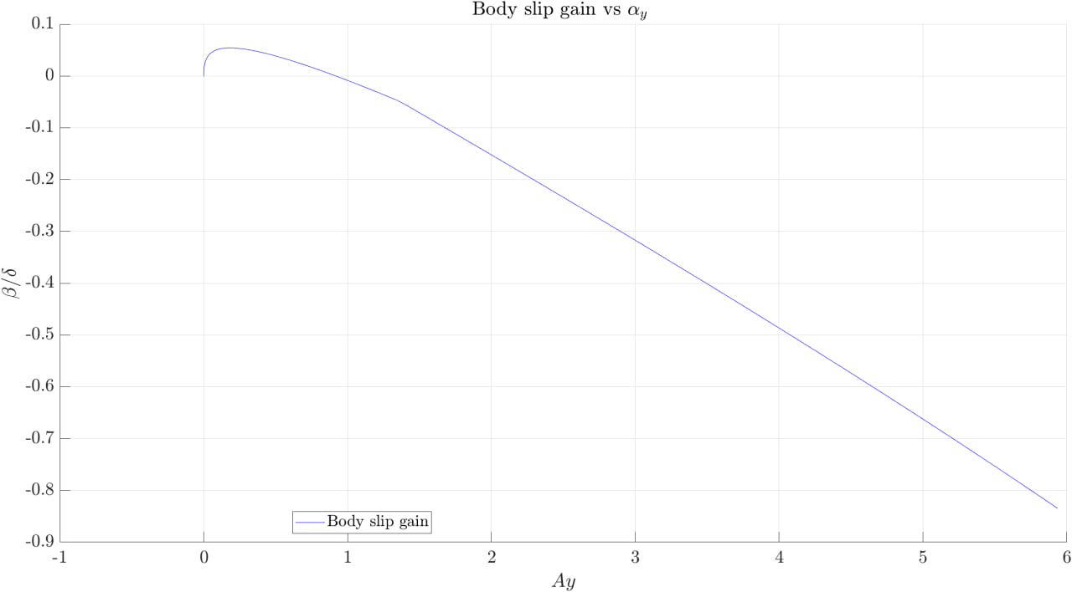

Body slip gain
As for the Yaw Rate, the Body Slip Gain is asymptotic when reaching the critical speed
$$u_{cr}=95 [{km}/h].$$
It is computed as:
$$\frac{β}{δ}$$
As expected, $β$ is initially positive (point outside the trajectory) and then turns negative (points inside the trajectory).

Slide 21
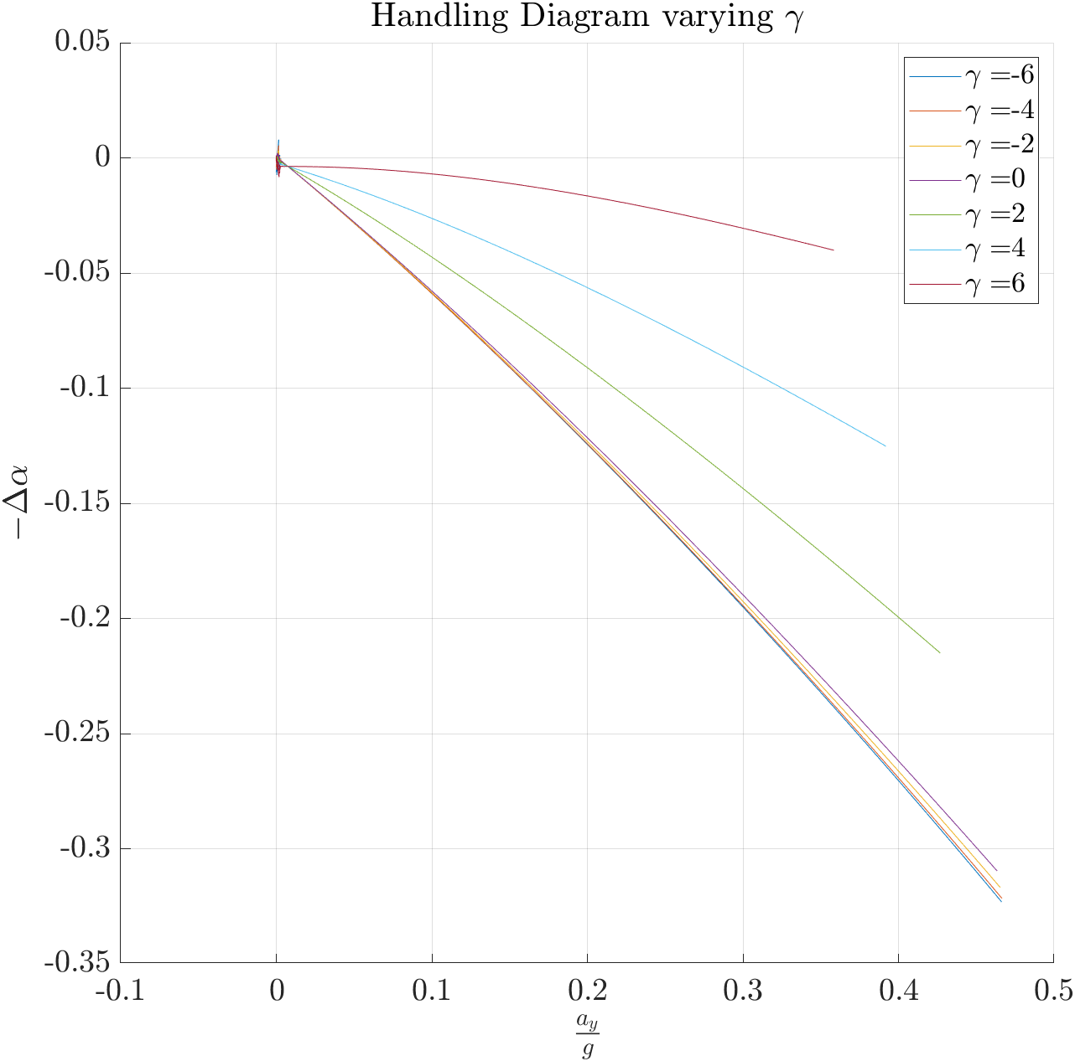
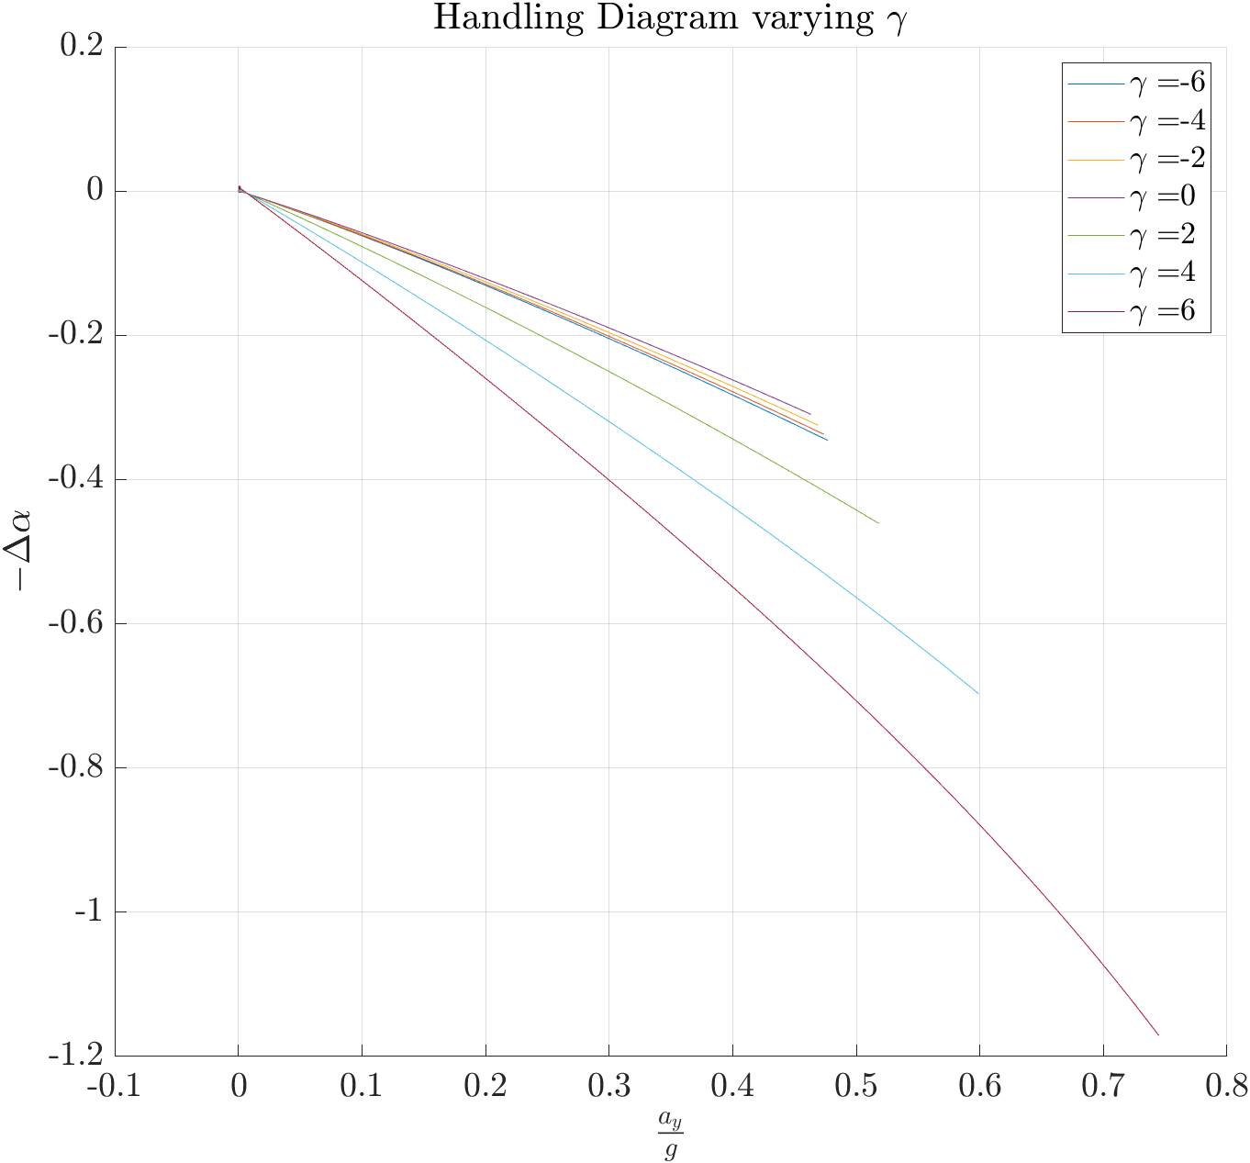
Handling diagram variation due to Camber changes
Front camber angles affect the overall vehicle behaviour: negative camber increases oversteering, for positive camber heightens understeering. The opposite is true for rear camber angles.
Front Camber
Rear Camber

Slide 22
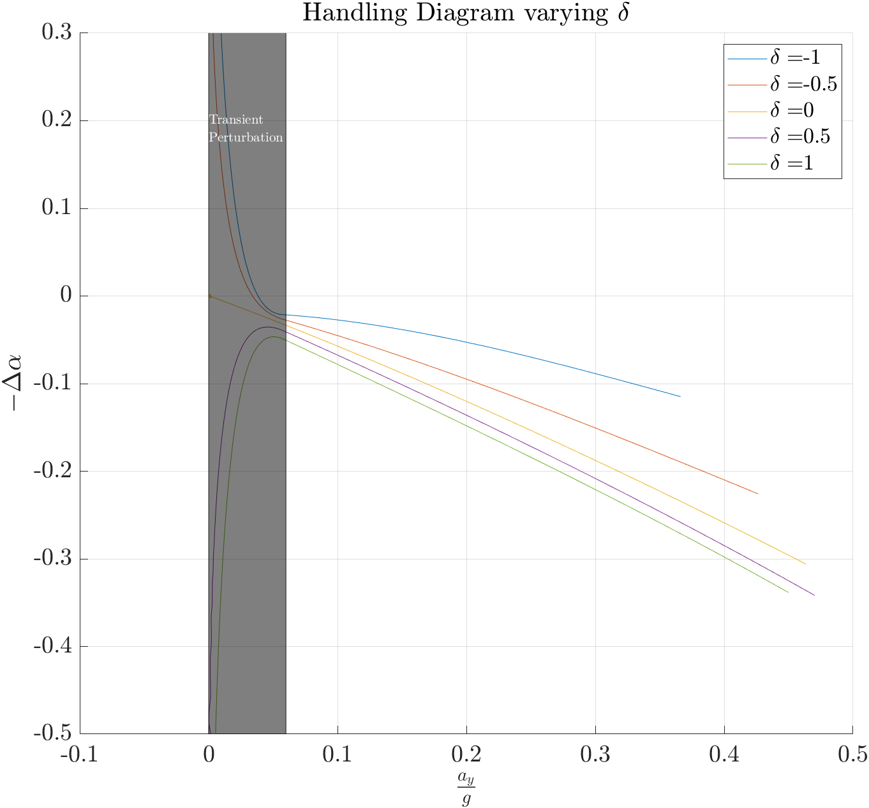
Handling diagram variation due to Toe angle changes
Transient perturbation causes the handling diagram to stabilise after about 0.06 ay/g. This has been counterbalanced to allow a better analysis of the results.
Positive toe angles generate more oversteering; negative toe angles make the vehicle more understeering.

Slide 23
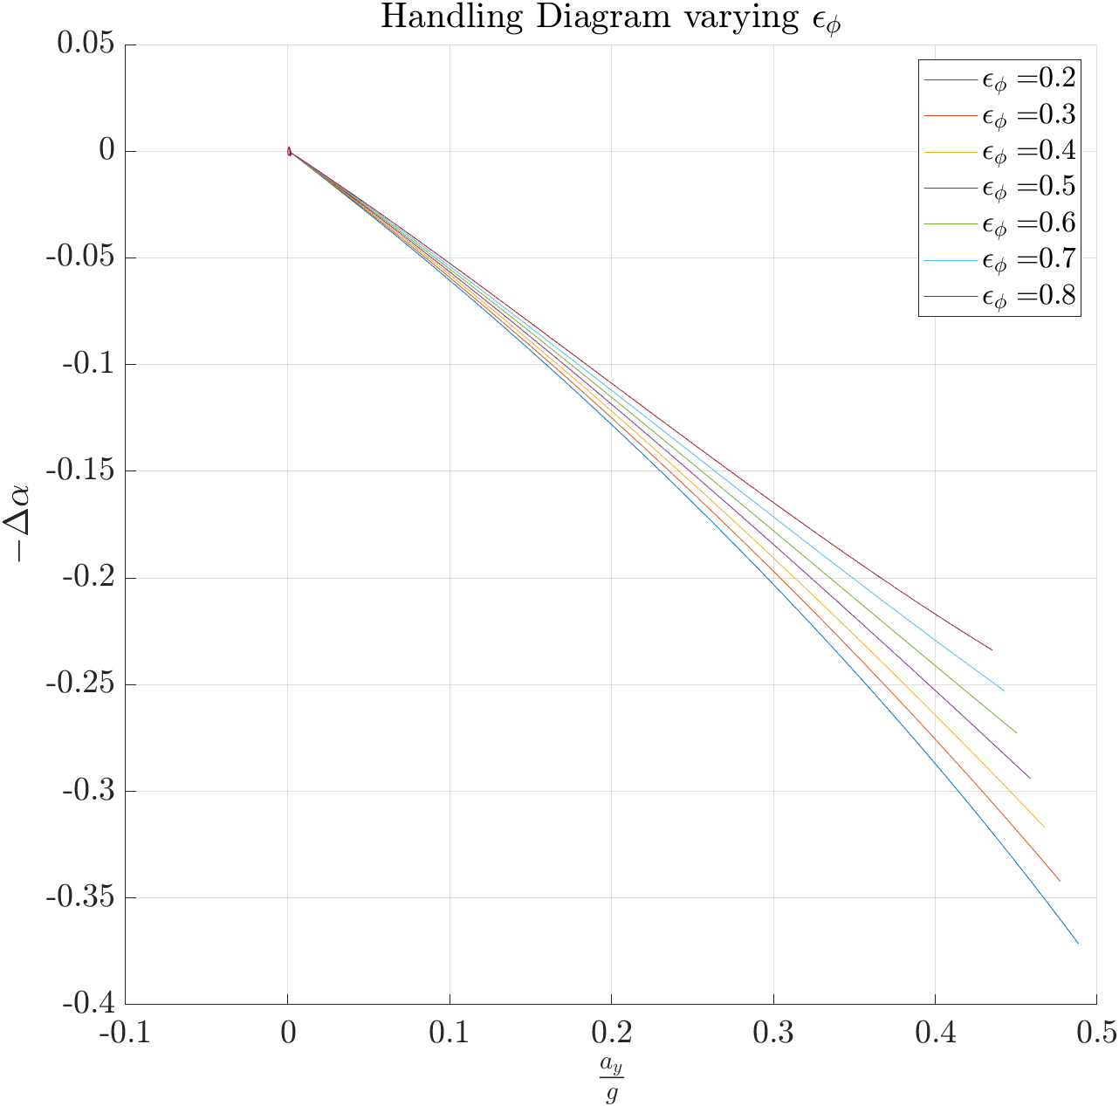

Handling diagram variation due to Stiffness changes
Varying the suspension rolling stiffness changes the lateral load transfer and the axle cornering stiffness. To do so, the ratio $ε_{Φ}$ has been applied to the front, while $\left(1−ε_{Φ}\right)$ has been applied to the rear. The ratio is defined as:
$ε_{Φ}$ = $\frac{K_{Φ_{f}}}{K_{Φ_{f}}+K_{Φ_{r}}}$
Higher front stiffness generates understeering behaviour; higher rear stiffness causes oversteering behaviour.

Slide 24

Thank You

